Slide 1
Unit - 2
Physical Layer

Slide 2
Contents [Chapter-3 to 8 from Forouzan]
1. | Basis for data communication | [Chapter-3 from Forouzan]
2. | Digital to digital and Analog to digital conversion | [Chapter-4 from Forouzan]
3. | Transmission modes | [Chapter-4 from Forouzan]
4. | Analog transmission: Digital to analog and analog to analog conversion | [Chapter-5 from Forouzan]
5. | Multiplexing and spreading techniques | [Chapter-6 from Forouzan]
6. | Switching techniques, types of switching, structure of switch, types of switches | [Chapter-8 from Forouzan]
7. | Guided Media and Unguided Media: Radio Frequency Allocation, frequency reuse | [Chapter-7 from Forouzan]

Slide 3
1. Basis for data communication
Data:
Analog data: information that is continuous & take continuous values
E.g. Analog clock – continuous movements of hands
Digital data: information that has discrete states & takes discrete values
E.g. Digital clock – time changes suddenly
Signals:
Analog Signal: It can have an infinite number of values in a range
Digital Signal: It can have only a limited number of values
Both Analog & Digital signals can take one of the following form:
Periodic Signal: It completes a pattern within a measurable time frame and repeats that pattern over subsequent identical periods
Nonperiodic Signal: It changes without exhibiting a pattern or cycle that repeats over time

Slide 4
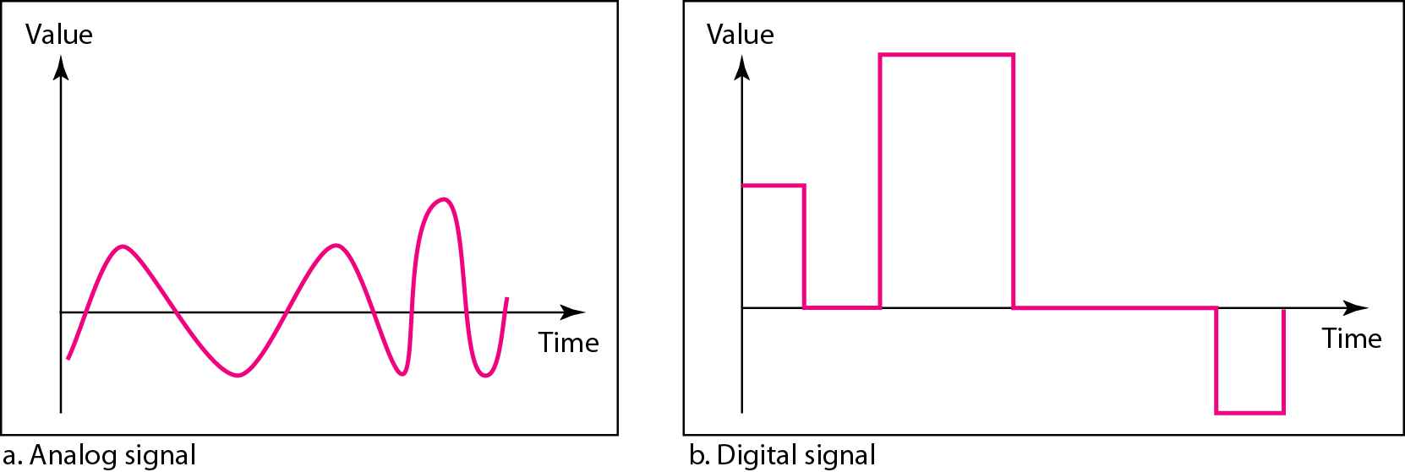
Figure 3.1 Comparison of analog and digital signals
In data communications, we commonly use
periodic analog signals (because they need less bandwidth)
and nonperiodic digital signals (because they can represent variation in data)

Slide 5
Signals
Analog Signal
Digital Signal
Analog & Digital Signals
Periodic Signal
Simple Periodic Signal / Sine wave
Composite Periodic Signal
Non-periodic Signal
Amplitude
Frequency
Phase

Slide 6
Analog Signals
Periodic Analog Signals
Simple: a sine wave, cannot be decomposed into simpler signals.
Composite: periodic analog signal is composed of multiple sine waves.
Sign wave / Simple Periodic Signal:
Each cycle consists of a single arc above the time axis followed by a single arc below it.
It can be represented by three parameters: the peak amplitude, the frequency, and the phase.

Slide 7
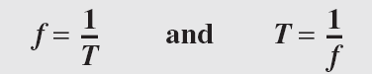
Peak amplitude:
It is the absolute value of its highest intensity, proportional to the energy it carries.
It is normally measured in volts.
Period (T) & Frequency(f):
Period: the amount of time (in seconds) a signal needs to complete 1 cycle
Cycle: The completion of one full pattern
Frequency: the number of periods in I s
Frequency and period are the inverse of each other
Phase:
It describes the position of the waveform relative to time 0
Phase is measured in degrees or radians

Slide 8
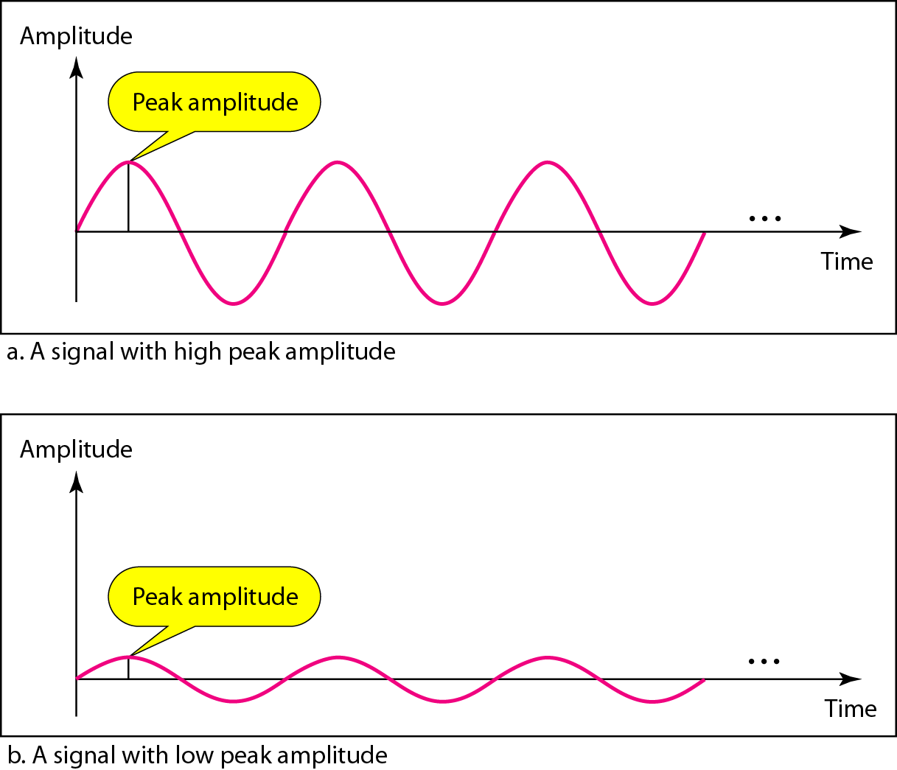
Figure 3.3 Two signals with the same phase and frequency, but different amplitudes

Slide 9
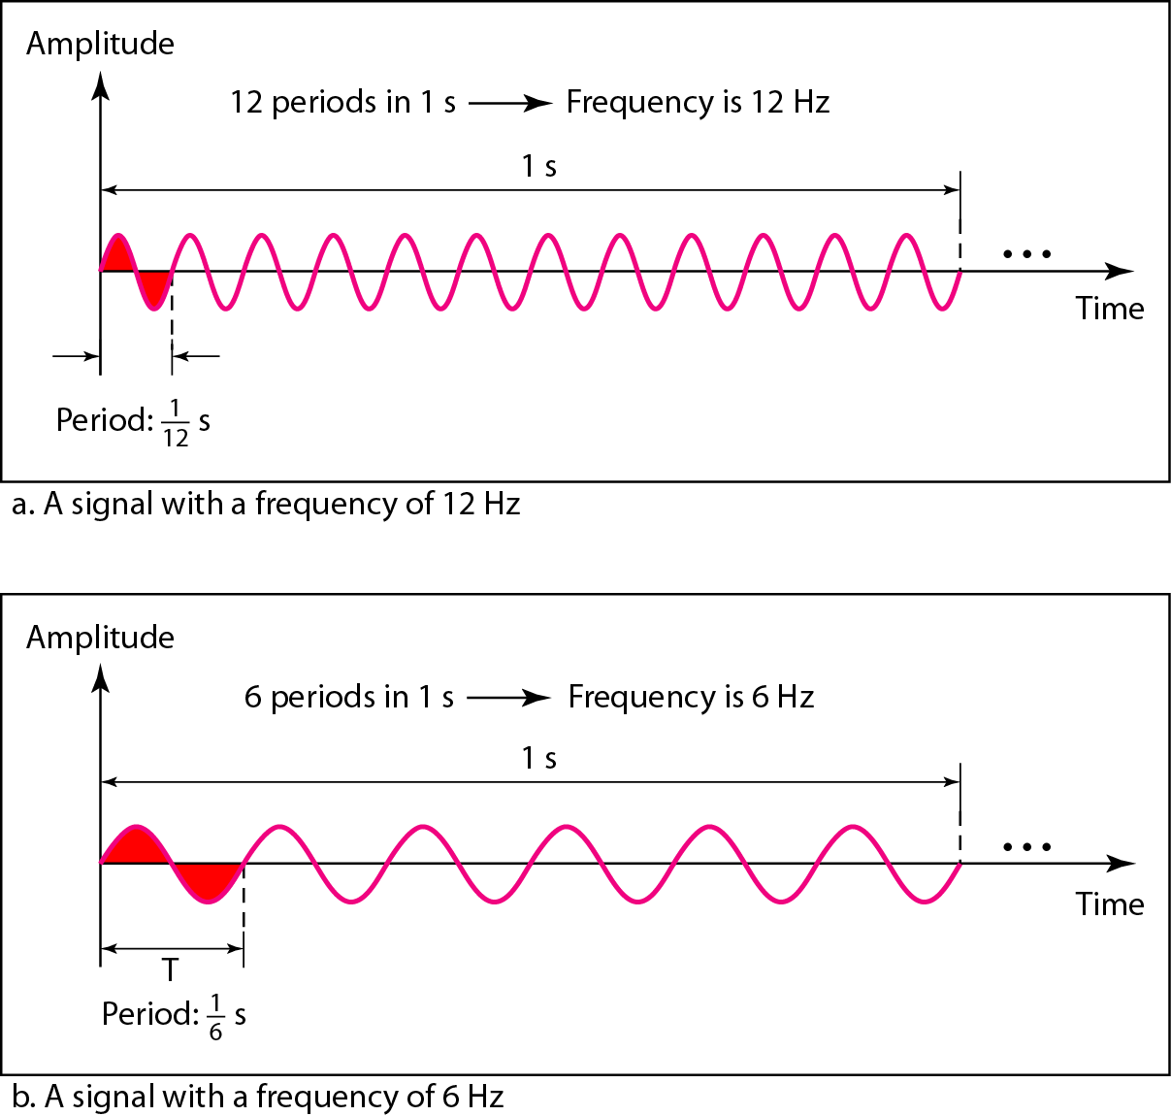
Figure 3.4 Two signals with the same amplitude and phase, but different frequencies

Slide 10
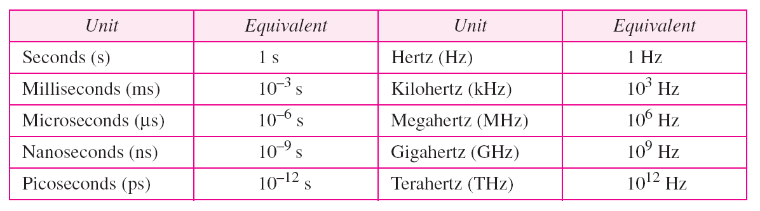
Table 3.1 Units of period and frequency

Slide 11
Example 3.3
The power we use at home has a frequency of 60 Hz. The period of this sine wave can be determined as follows:

Slide 12
Example 3.4
Express a period of 100 ms in microseconds.
Solution
find the equivalents of 1 ms (1 ms is 10⁻³ s) and 1 s (1 s is 10⁶ μs). We make the following substitutions:.

Slide 13
Example 3.5
The period of a signal is 100 ms. What is its frequency in kilohertz?
Solution
First we change 100 ms to seconds, and then we calculate the frequency from the period (1 Hz = 10⁻³ kHz).

Slide 14

Note
Frequency is the rate of change with respect to time. Change in a short span of time
means high frequency. Change over a long span of time means low frequency.

Slide 15
Note
If a signal does not change at all, its frequency is zero.
If a signal changes instantaneously, its frequency is infinite.

Slide 16
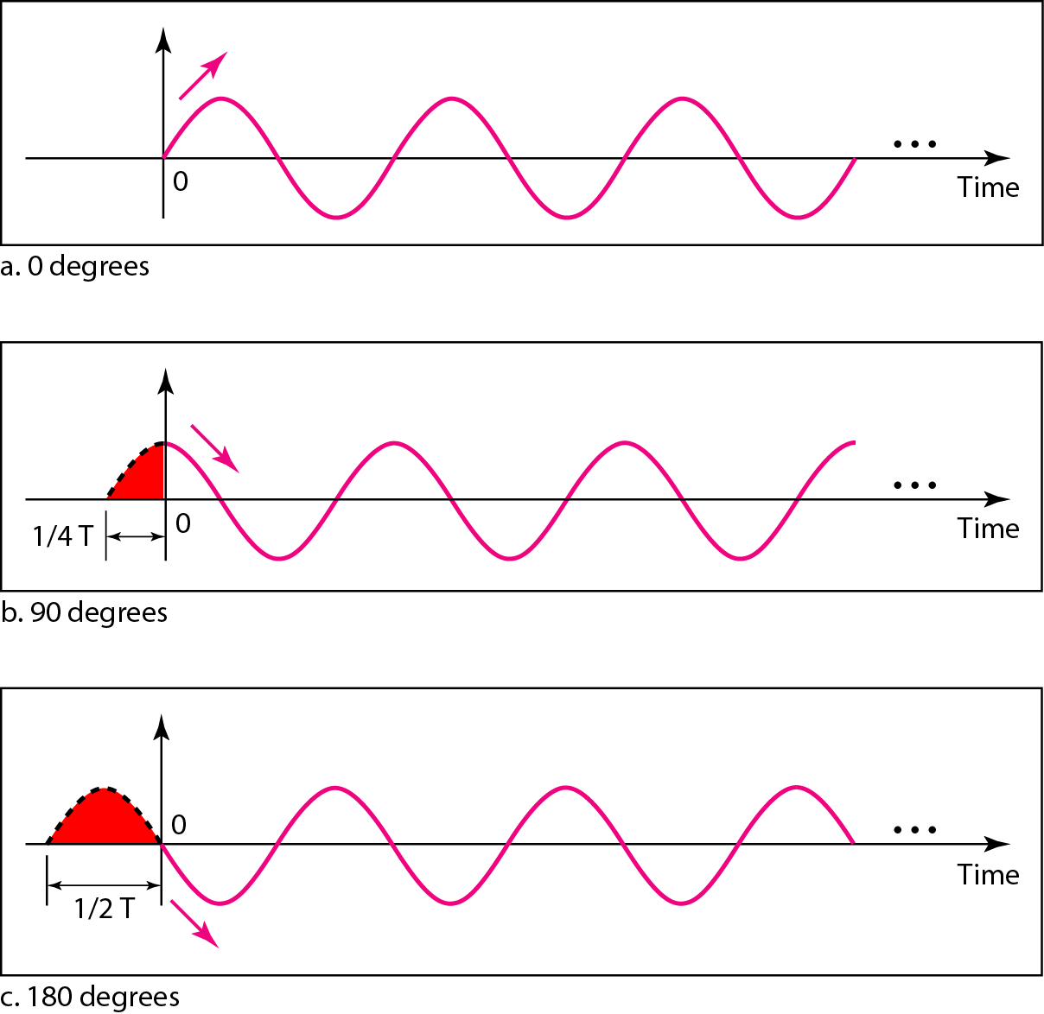
Figure 3.5 Three sine waves with the same amplitude and frequency, but different phases

Slide 17
Example 3.6
A sine wave is offset 1/6 cycle with respect to time 0. What is its phase in degrees and radians?
Solution
We know that 1 complete cycle is 360°. Therefore, 1/6 cycle is
Radian = degree x π / 180

Slide 18
Wavelength:
It is another characteristic of a signal traveling through a transmission medium.
It binds the period or the frequency of a simple wave to the propagation speed of the medium.

Slide 19
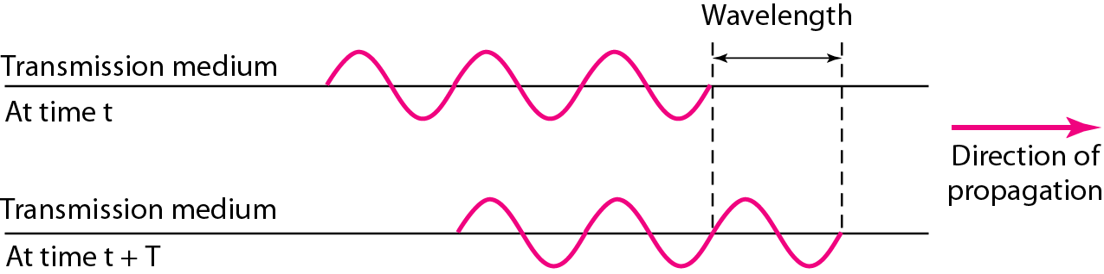
Figure 3.6 Wavelength and period
$$Wavelength=propagation speed ×period= \frac{propagation speed}{frequency}$$

Slide 20
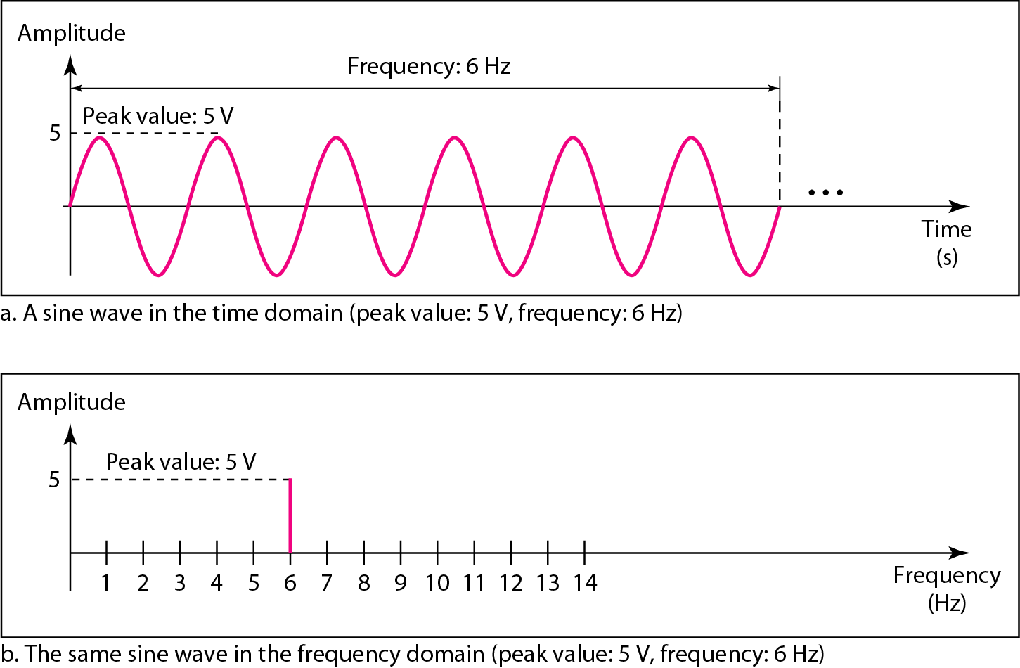
A complete sine wave in the time domain can be represented by one single spike in the frequency domain.
Figure 3.7 The time-domain and frequency-domain plots of a sine wave

Slide 21
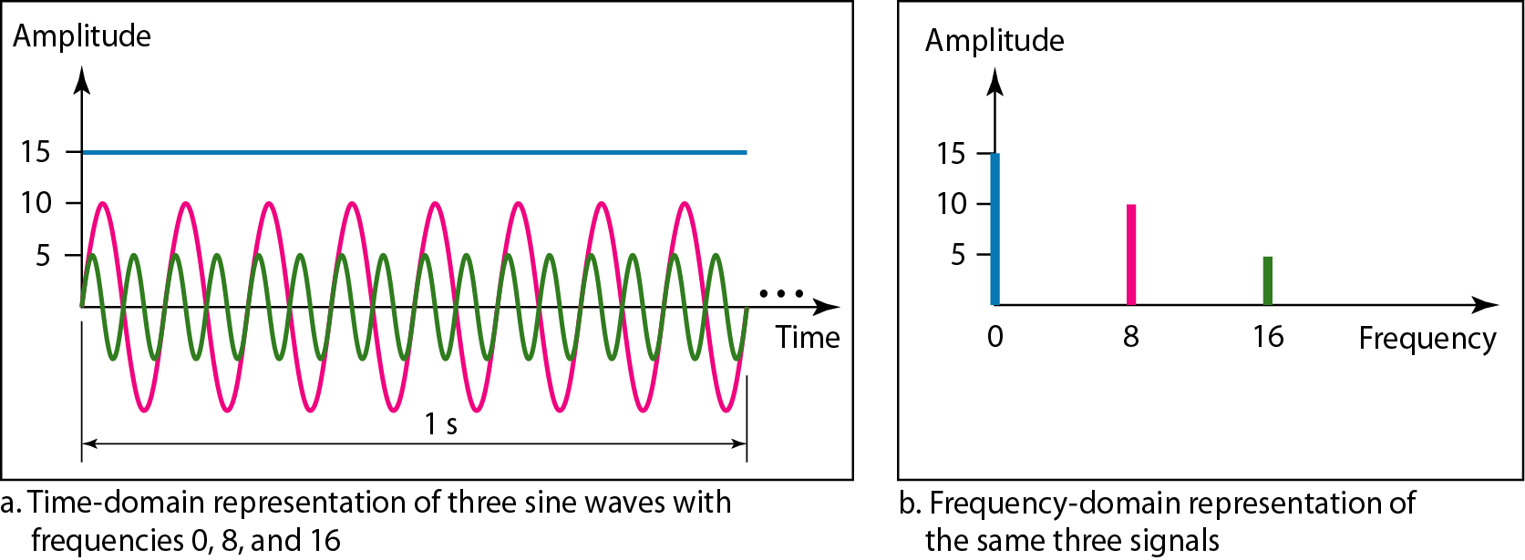
The frequency domain is more compact and useful when we are dealing with more than one sine wave.
For example, Figure shows three sine waves, each with different amplitude and frequency.
All can be represented by three spikes in the frequency domain.
Figure 3.8 The time domain and frequency domain of three sine waves

Slide 22
Composite Periodic Signal
A single-frequency sine wave is not useful in data communications; we need to send a composite signal, a signal made of many simple sine waves.
According to Fourier analysis, any composite signal is a combination of simple sine waves with different frequencies, amplitudes, and phases.
If the composite signal is periodic, the decomposition gives a series of signals with discrete frequencies
If the composite signal is nonperiodic, the decomposition gives a combination of sine waves with continuous frequencies.

Slide 23
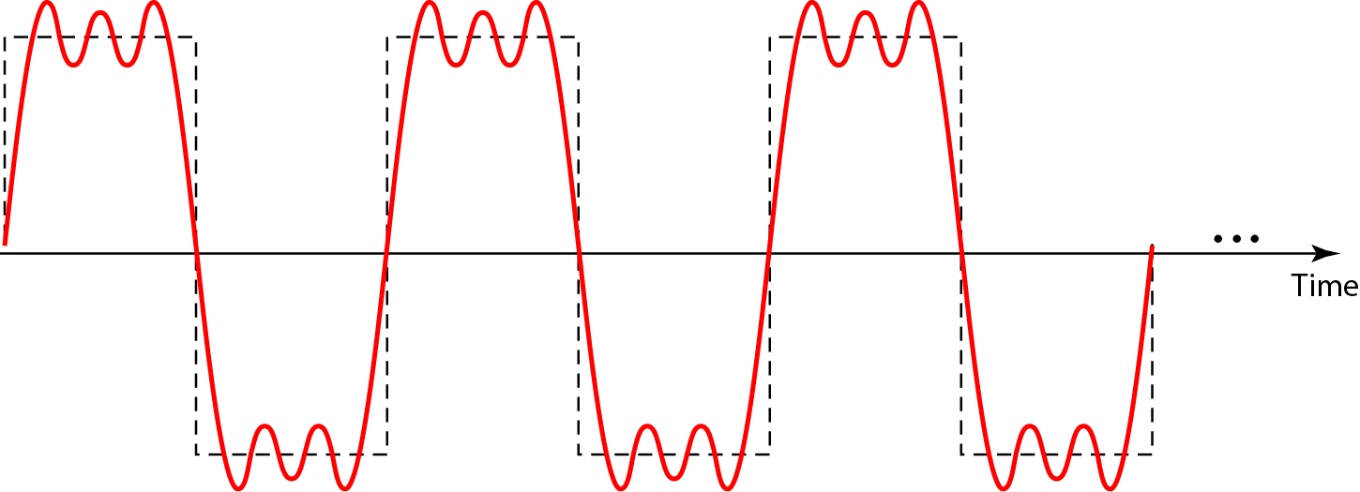
Figure 3.9 A composite periodic signal

Slide 24
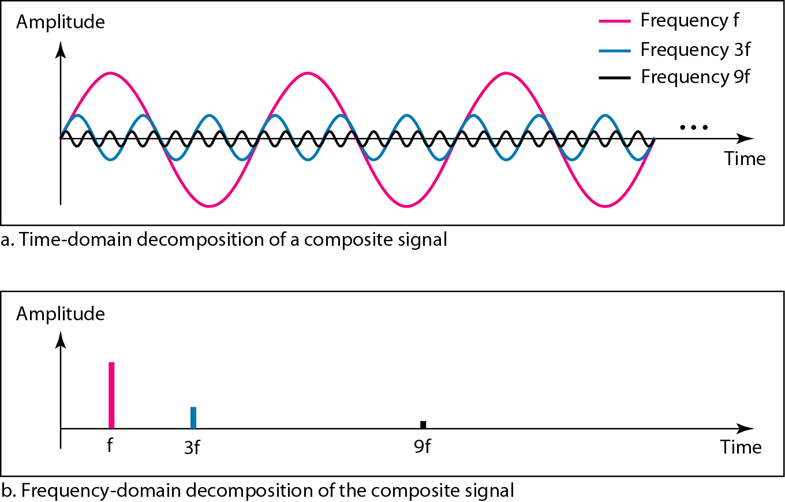
Figure 3.10 Decomposition of a composite periodic signal in the time and frequency domains

Slide 25
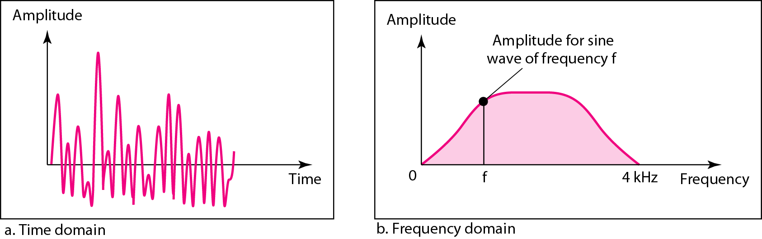
Figure 3.11 The time and frequency domains of a nonperiodic signal

Slide 26
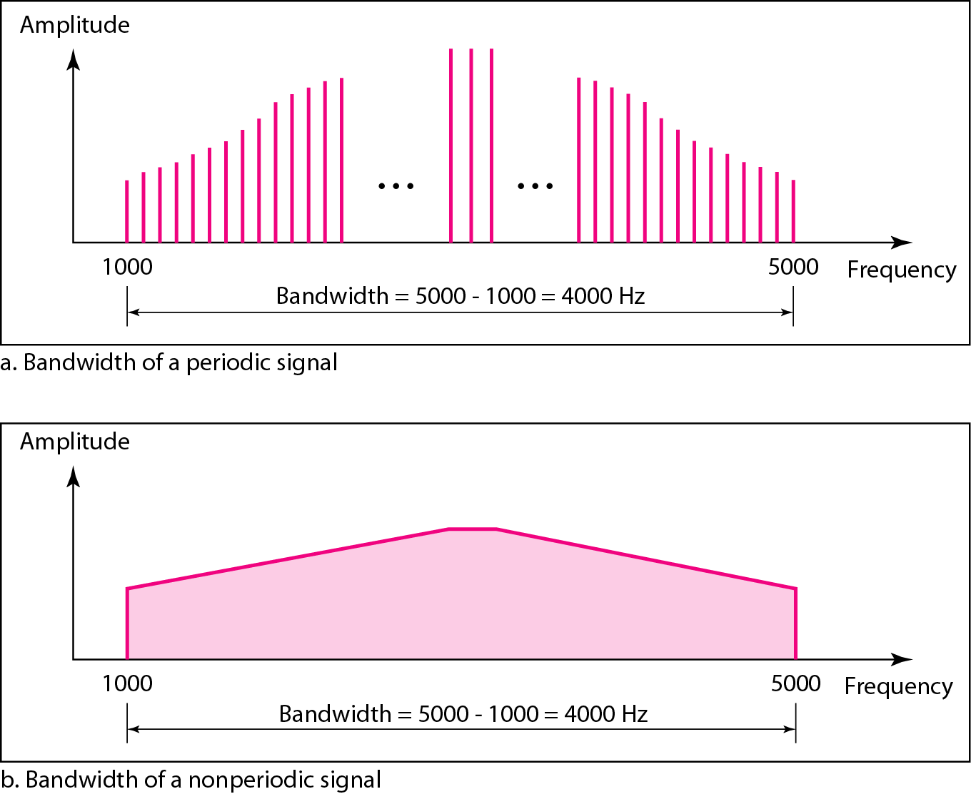
The bandwidth of a composite signal is the difference between the
highest and the lowest frequencies contained in that signal.
Figure 3.12 The bandwidth of periodic and nonperiodic composite signals

Slide 27
Example 3.10
If a periodic signal is decomposed into five sine waves with frequencies of 100, 300, 500, 700, and 900 Hz, what is its bandwidth? Draw the spectrum, assuming all components have a maximum amplitude of 10 V.
Solution
Let f_{h} be the highest frequency, f_{l} the lowest frequency, and B the bandwidth. Then
The spectrum has only five spikes, at 100, 300, 500, 700, and 900 Hz (see Figure 3.13).

Slide 28
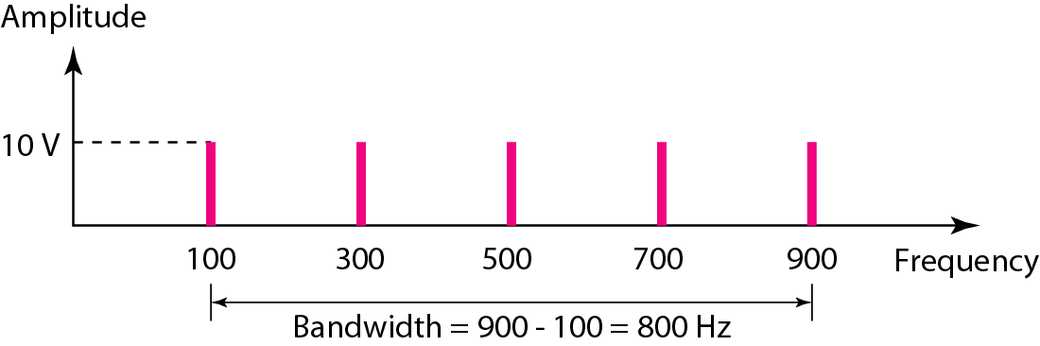
Figure 3.13 The bandwidth for Example 3.10

Slide 29
Example 3.11
A periodic signal has a bandwidth of 20 Hz. The highest frequency is 60 Hz. What is the lowest frequency? Draw the spectrum if the signal contains all frequencies of the same amplitude.
Solution
Let f_{h} be the highest frequency, f_{l} the lowest frequency, and B the bandwidth. Then
The spectrum contains all integer frequencies. We show this by a series of spikes (see Figure 3.14).

Slide 30
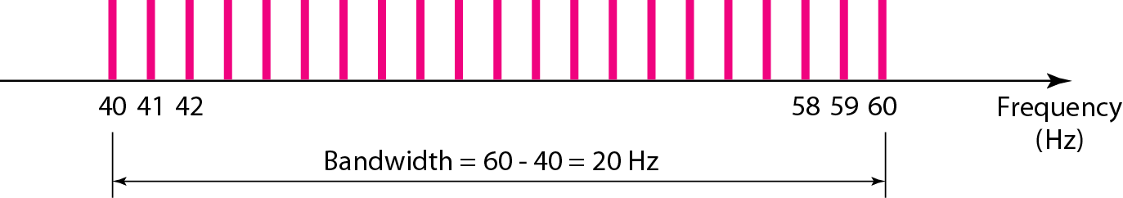
Figure 3.14 The bandwidth for Example 3.11

Slide 31
Example 3.12
A nonperiodic composite signal has a bandwidth of 200 kHz, with a middle frequency of 140 kHz and peak amplitude of 20 V. The two extreme frequencies have an amplitude of 0. Draw the frequency domain of the signal.
Solution
The lowest frequency must be at 40 kHz and the highest at 240 kHz. Figure 3.15 shows the frequency domain and the bandwidth.

Slide 32
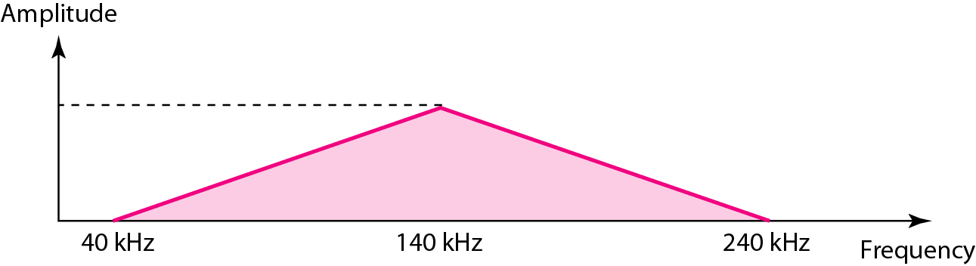
Figure 3.15 The bandwidth for Example 3.12

Slide 33
Digital Signals
A digital signal can have more than two levels.
In this case, we can send more than 1 bit for each level.
For example, a 1 can be encoded as a positive voltage and a 0 as zero voltage.

Slide 34
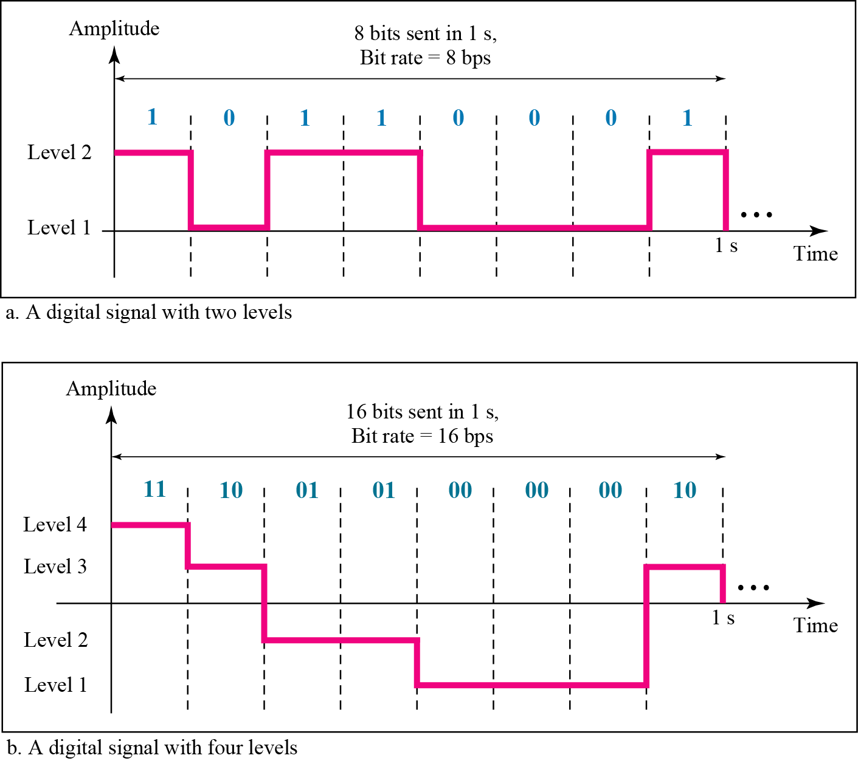
Figure 3.16 Two digital signals: one with two signal levels and the other with four signal levels

Slide 35
Example 3.16 & 3.17
1) A digital signal has eight levels. How many bits are needed per level? We calculate the number of bits from the formula
Each signal level is represented by 3 bits.
2) A digital signal has nine levels. How many bits are needed per level? We calculate the number of bits by using the formula. Each signal level is represented by 3.17 bits. However, this answer is not realistic. The number of bits sent per level needs to be an integer as well as a power of 2. For this example, 4 bits can represent one level.

Slide 36
Example 3.18
Assume we need to download text documents at the rate of 100 pages per minute. What is the required bit rate of the channel?
Solution
A page is an average of 24 lines with 80 characters in each line. If we assume that one character requires 8 bits, the bit rate is

Slide 37
Example 3.19
A digitized voice channel, as we will see in Chapter 4, is made by digitizing a 4-kHz bandwidth analog voice signal. We need to sample the signal at twice the highest frequency (two samples per hertz). We assume that each sample requires 8 bits. What is the required bit rate?
Solution
The bit rate can be calculated as

Slide 38
Example 3.20
What is the bit rate for high-definition TV (HDTV)?
Solution
HDTV uses digital signals to broadcast high quality video signals. The HDTV screen is normally a ratio of 16 : 9. There are 1920 by 1080 pixels per screen, and the screen is renewed 30 times per second. Twenty-four bits represents one color pixel.
The TV stations reduce this rate to 20 to 40 Mbps through compression.

Slide 39
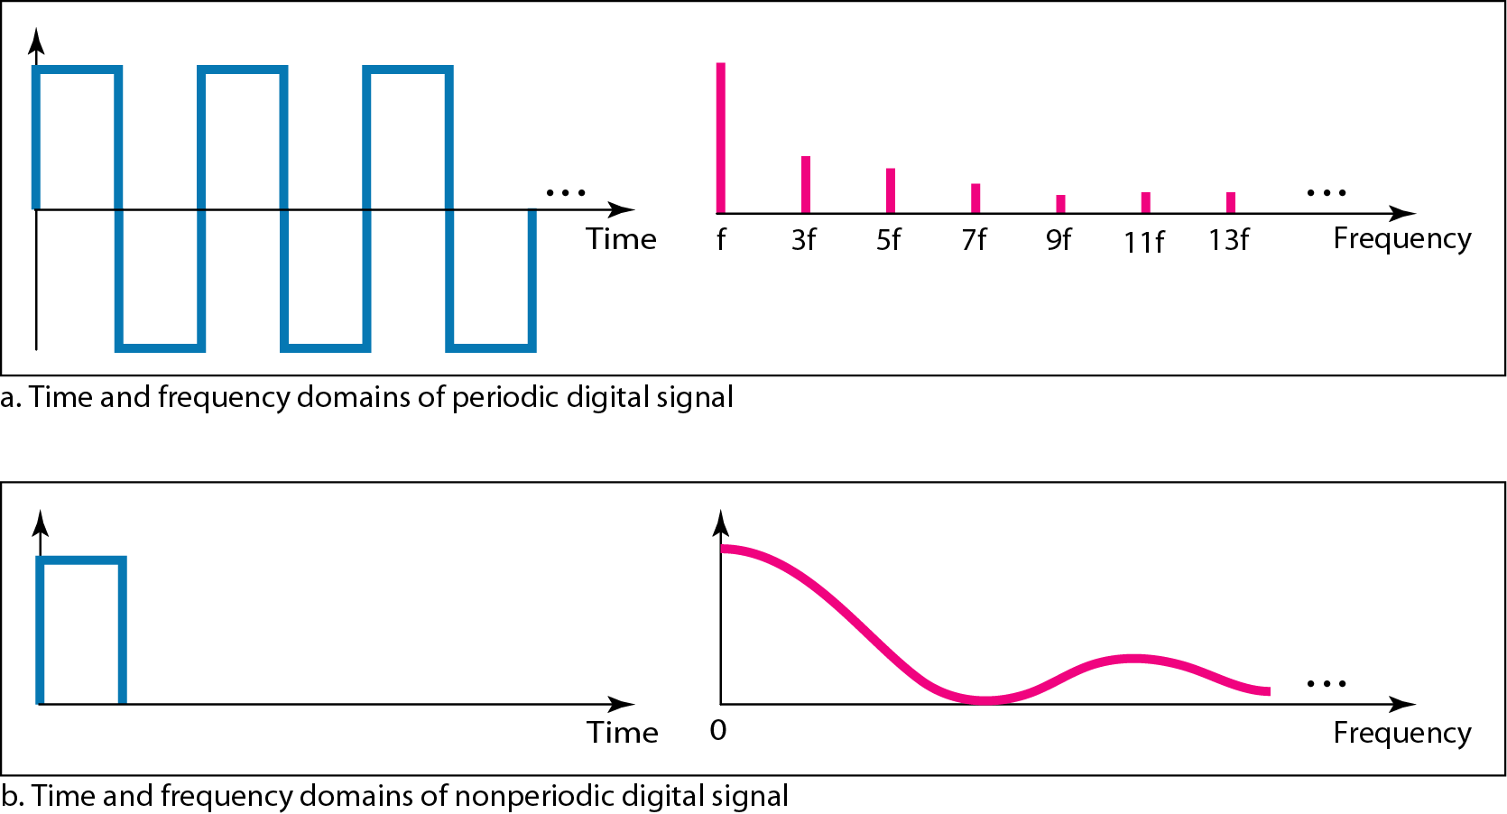
Figure 3.17 The time and frequency domains of periodic and nonperiodic digital signals

Slide 40
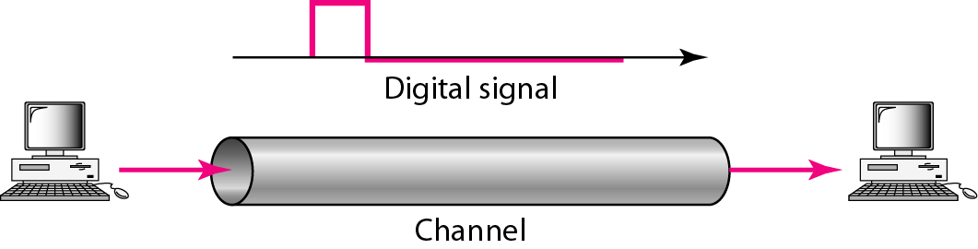
Figure 3.18 Baseband transmission

Slide 41
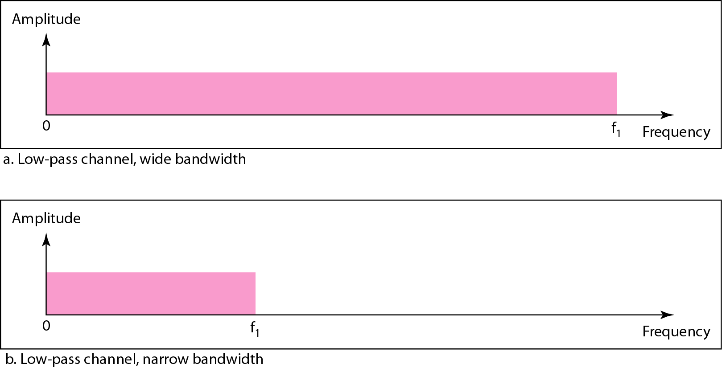
Figure 3.19 Bandwidths of two low-pass channels

Slide 42
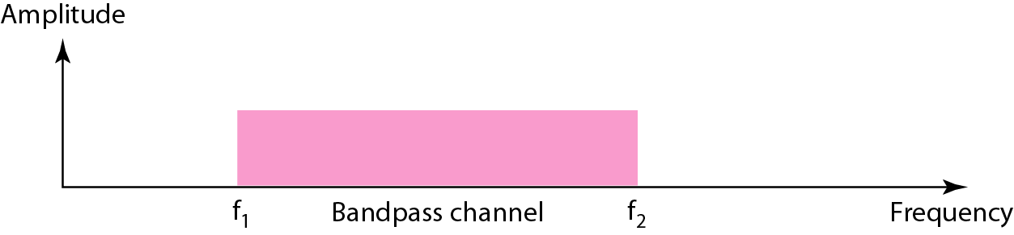
Figure 3.23 Broadband transmission Bandwidth of a bandpass channel
A bandwidth that doesnot start from zero.
low-pass channel can be considered a bandpass channel with the lower frequency starting at zero.

Slide 43
Example 3.24
An example of broadband transmission using modulation is the sending of computer data through a telephone subscriber line, the line connecting a resident to the central telephone office. These lines are designed to carry voice with a limited bandwidth. The channel is considered a bandpass channel. We convert the digital signal from the computer to an analog signal, and send the analog signal. We can install two converters to change the digital signal to analog and vice versa at the receiving end. The converter, in this case, is called a modem which we discuss in detail in Chapter 5.

Slide 44
3-4 TRANSMISSION IMPAIRMENT
Signals travel through transmission media, which are not perfect. The imperfection causes signal impairment. This means that the signal at the beginning of the medium is not the same as the signal at the end of the medium. What is sent is not what is received. Three causes of impairment are attenuation, distortion, and noise.
Topics discussed in this section:
Attenuation Distortion Noise

Slide 45
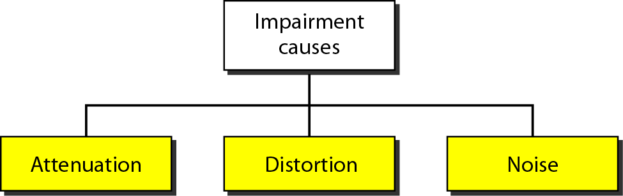
Figure 3.25 Causes of impairment

Slide 46
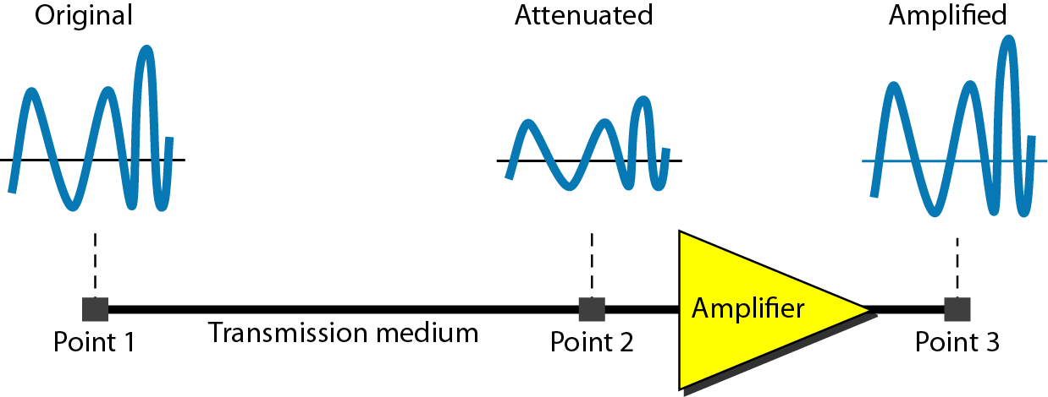
Figure 3.26 Attenuation

Slide 47
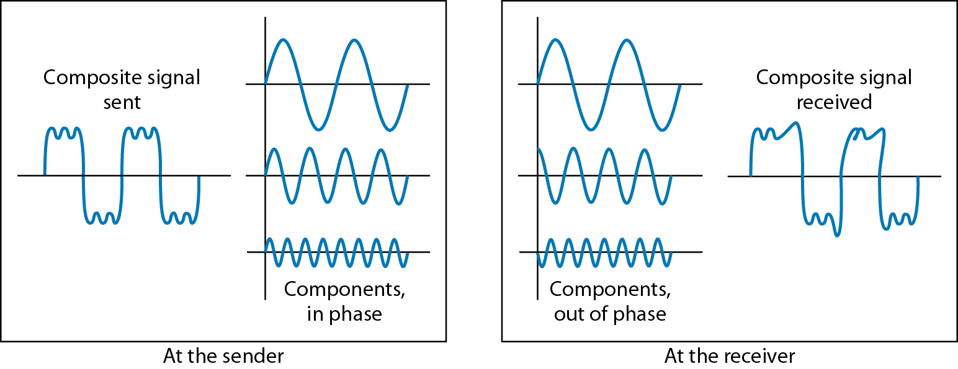
Figure 3.28 Distortion

Slide 48
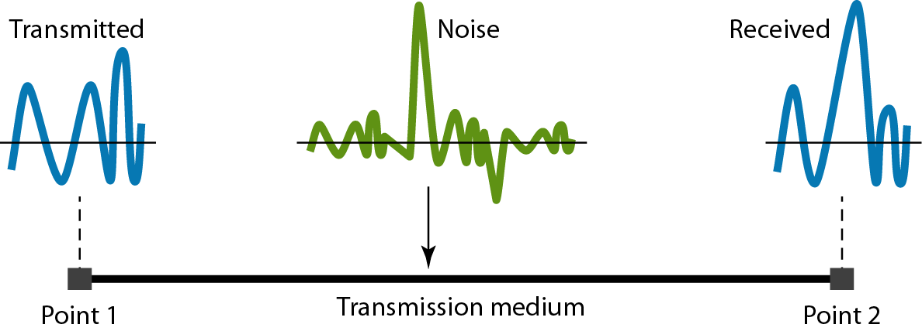
Figure 3.29 Noise

Slide 49
Example 3.31
The power of a signal is 10 mW and the power of the noise is 1 μW; what are the values of SNR and SNR_{dB} ?
Solution
The values of SNR and SNRdB can be calculated as follows:

Slide 50
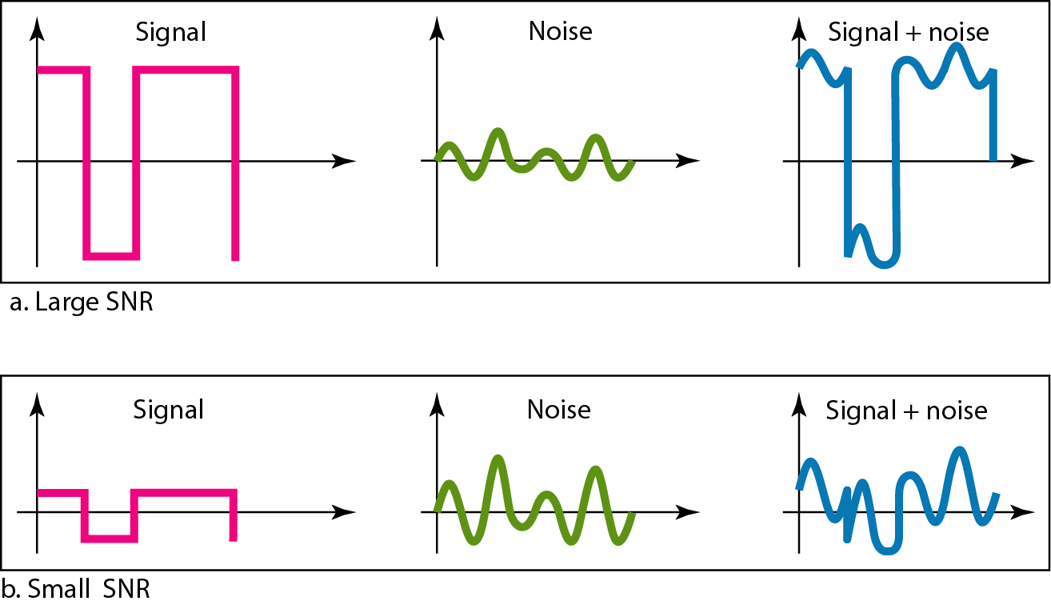
Figure 3.30 Two cases of SNR: a high SNR and a low SNR

Slide 51

Example 3.44
A network with bandwidth of 10 Mbps can pass only an average of 12,000 frames per minute with each frame carrying an average of 10,000 bits. What is the throughput of this network?
Solution
We can calculate the throughput as
The throughput is almost one-fifth of the bandwidth in this case.

Slide 52
Example 3.45
What is the propagation time if the distance between the two points is 12,000 km? Assume the propagation speed to be 2.4 × 108 m/s in cable.
Solution
We can calculate the propagation time as
The example shows that a bit can go over the Atlantic Ocean in only 50 ms if there is a direct cable between the source and the destination.

Slide 53
Example 3.46
What are the propagation time and the transmission time for a 2.5-kbyte message (an e-mail) if the bandwidth of the network is 1 Gbps? Assume that the distance between the sender and the receiver is 12,000 km and that light travels at 2.4 × 108 m/s.
Solution
We can calculate the propagation and transmission time as shown on the next slide:

Slide 54
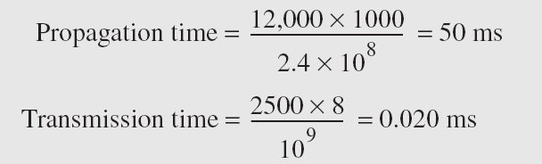
Example 3.46 (continued)
Note that in this case, because the message is short and the bandwidth is high, the dominant factor is the propagation time, not the transmission time. The transmission time can be ignored.

Slide 55
Example 3.47
What are the propagation time and the transmission time for a 5-Mbyte message (an image) if the bandwidth of the network is 1 Mbps? Assume that the distance between the sender and the receiver is 12,000 km and that light travels at 2.4 × 10⁸ m/s.
Solution
We can calculate the propagation and transmission times as shown on the next slide.

Slide 56
Example 3.47 (continued)
Note that in this case, because the message is very long and the bandwidth is not very high, the dominant factor is the transmission time, not the propagation time. The propagation time can be ignored.

Slide 57

Chapter 4
Digital Transmission
Copyright © The McGraw-Hill Companies, Inc. Permission required for reproduction or display.

Slide 58
4-1 DIGITAL-TO-DIGITAL CONVERSION
In this section, we see how we can represent digital data by using digital signals. The conversion involves three techniques: line coding, block coding, and scrambling. Line coding is always needed; block coding and scrambling may or may not be needed.
Topics discussed in this section:
Line Coding
Line Coding Schemes Block Coding
Scrambling

Slide 59
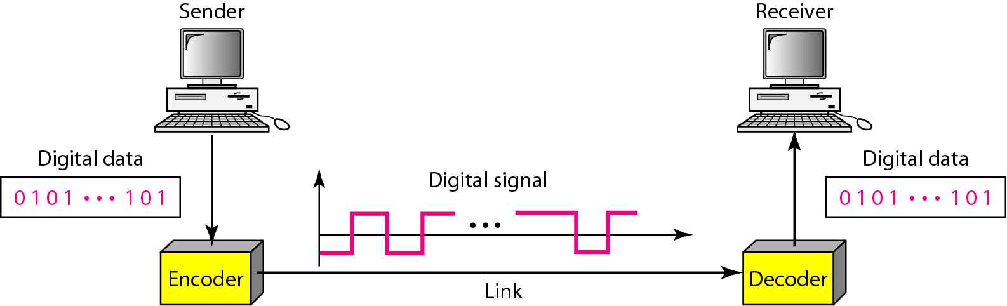
Figure 4.1 Line coding and decoding

Slide 60
Signal Element Versus Data Element:
Data element is the smallest entity that can represent a piece of information (i.e. bit)
Signal element is the shortest unit (time-wise) of a digital signal
A ratio r is defined, which is the number of data elements carried by each signal element
Data Rate Versus Signal Rate:
The data rate defines the number of data elements (bits) sent in 1s. The unit is bits per second (bps).
The signal rate is the number of signal elements sent in 1s. The unit is the baud.
Signal rate is sometimes called pulse rate, the modulation rate, or the baud rate

Slide 61
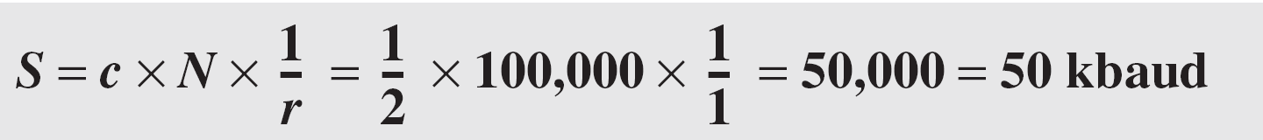
Note
Relationship between data rate and signal rate:
N is the data rate (bps)
c is the case factor, which varies for each case; S is the number of signal elements;
r is the previously defined factor

Slide 62
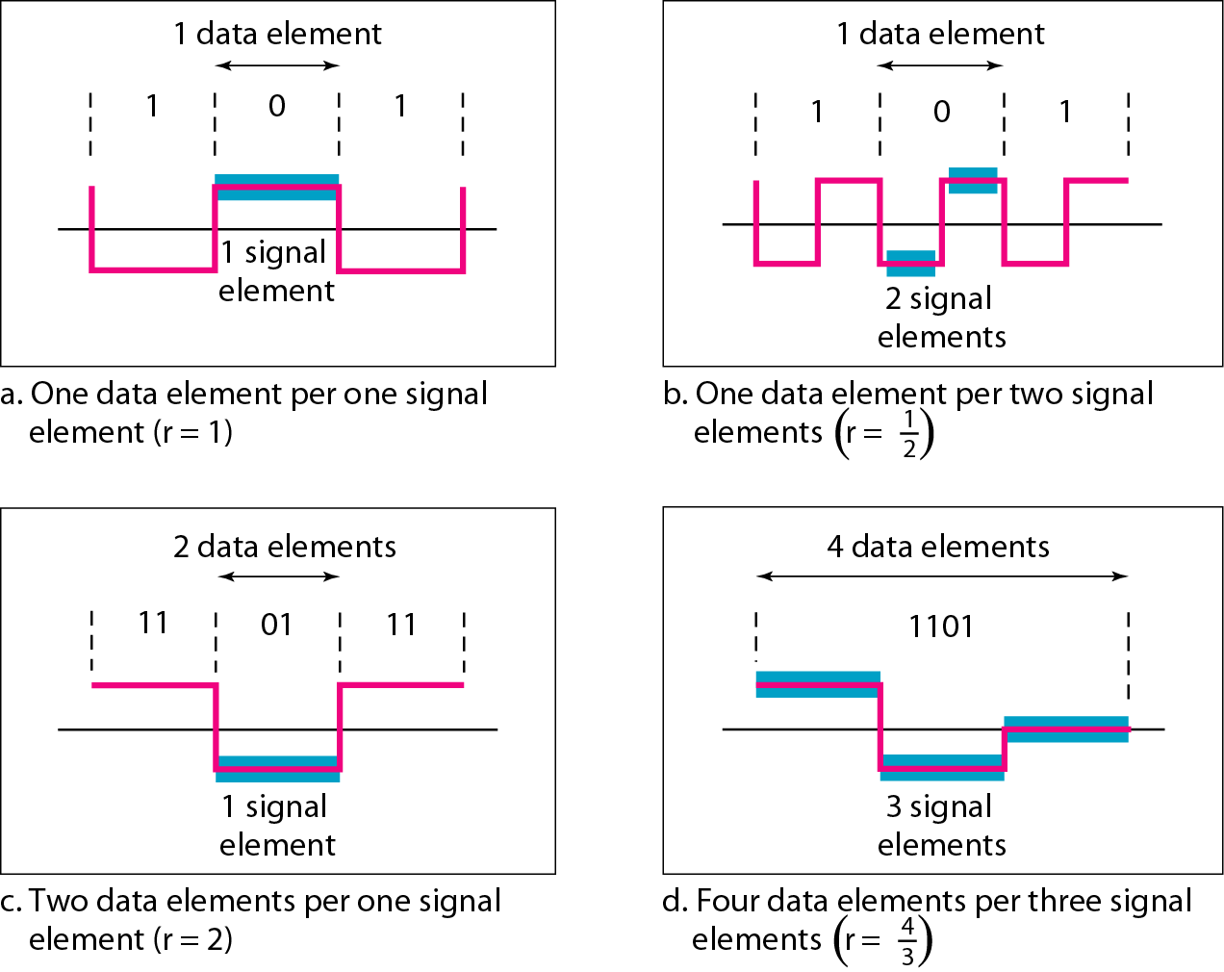
Figure 4.2 Signal element versus data element

Slide 63
Example 4.1
A signal is carrying data in which one data element is encoded as one signal element ( r = 1). If the bit rate is 100 kbps, what is the average value of the baud rate if c is between 0 and 1?
Solution
We assume that the average value of c is 1/2 . The baud rate is then

Slide 64
Note
Although the actual bandwidth of a digital signal is infinite, the effective bandwidth is finite.

Slide 65
Example 4.2
The maximum data rate of a channel (see Chapter 3) is Nmax = 2 × B × log₂ L (defined by the Nyquist formula). Does this agree with the previous formula for N_{max}?
Solution
A signal with L levels actually can carry log₂L bits per level. If each level corresponds to one signal element and we assume the average case (c = 1/2), then we have

Slide 66
Factors
Baseline Wandering
A running average of the received signal power calculated by receiver is called the baseline. A long string of 0s or 1s can cause a drift in the baseline which is called baseline wandering
DC Components
When the voltage level in a digital signal is constant for a while, the spectrum creates very low frequencies. Those frequencies around zero are called DC (Direct-current) Components
Self-sychronization
A self-synchronizing digital signal includes timing information in the data being transmitted.

Slide 67
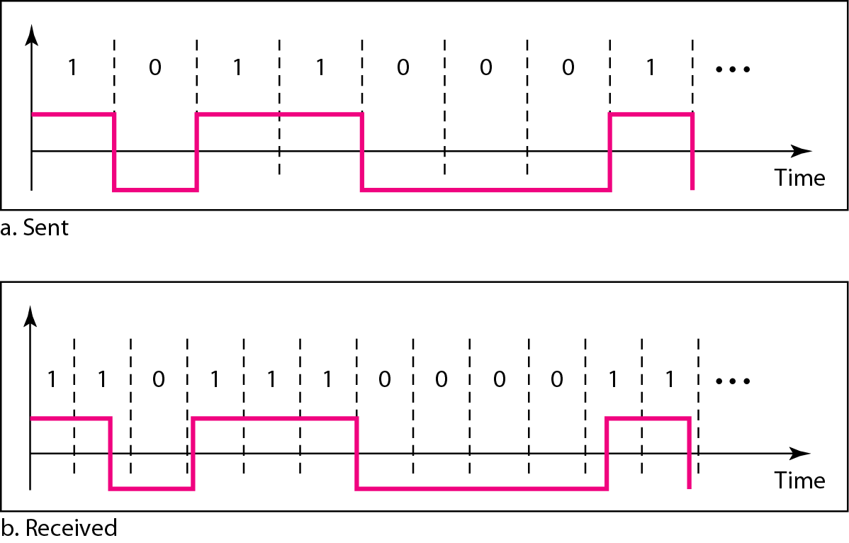
Figure 4.3 Effect of lack of synchronization

Slide 68
Example 4.3
In a digital transmission, the receiver clock is 0.1 percent faster than the sender clock. How many extra bits per second does the receiver receive if the data rate is 1 kbps? How many if the data rate is 1 Mbps?
Solution
At 1 kbps, the receiver receives 1001 bps instead of 1000 bps.
At 1 Mbps, the receiver receives 1,001,000 bps instead of 1,000,000 bps.

Slide 69
Factors
Built-in Error Detection
It is desirable to have a built-in error-detecting capability in the generated code to detect some of or all the errors that occurred during transmission.
Immunity to Noise and Interference
It is a another desirable code characteristic. Some encoding schemes have this capability.
Complexity
A complex scheme is more costly to implement than a simple one. For example, a scheme that uses four signal levels is more difficult to interpret than one that uses only two levels.

Slide 70
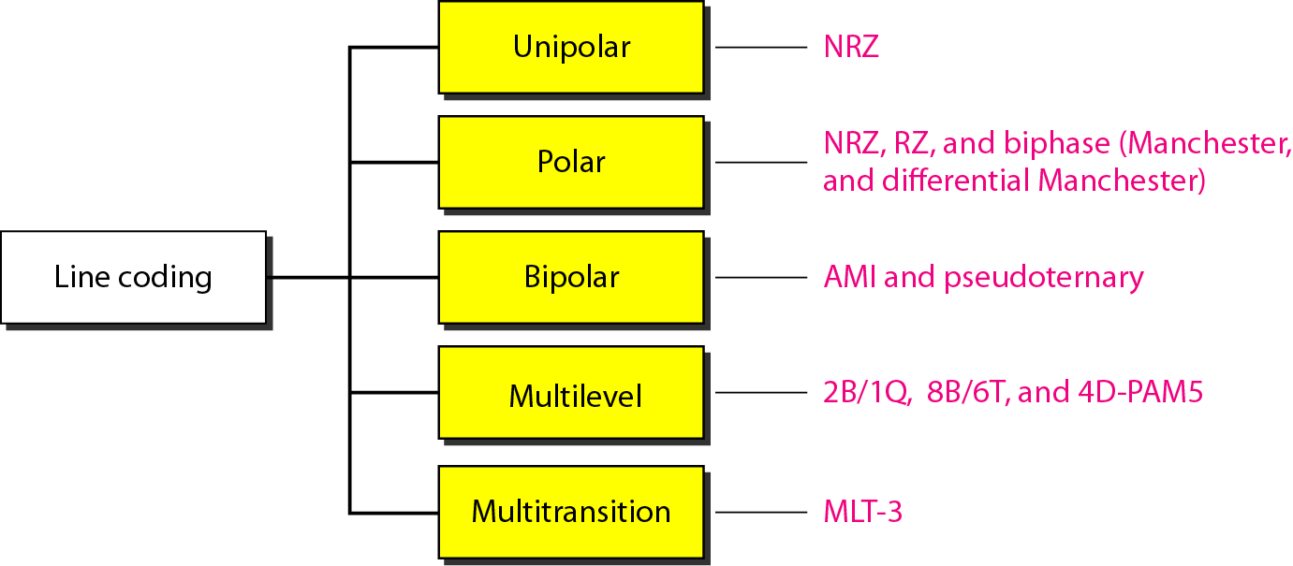
LINE CODING SCHEMES
Figure 4.4 Line coding schemes

Slide 71
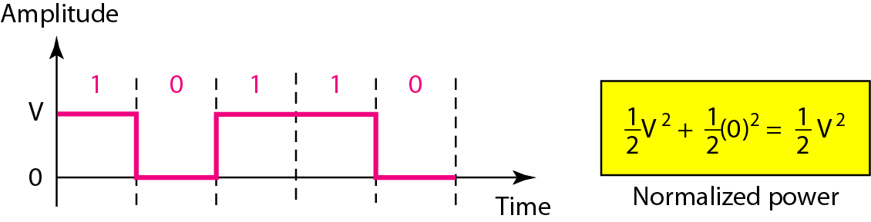
1. Unipolar Line Coding
1.1 NRZ Scheme
Figure 4.5 Unipolar NRZ scheme

Slide 72
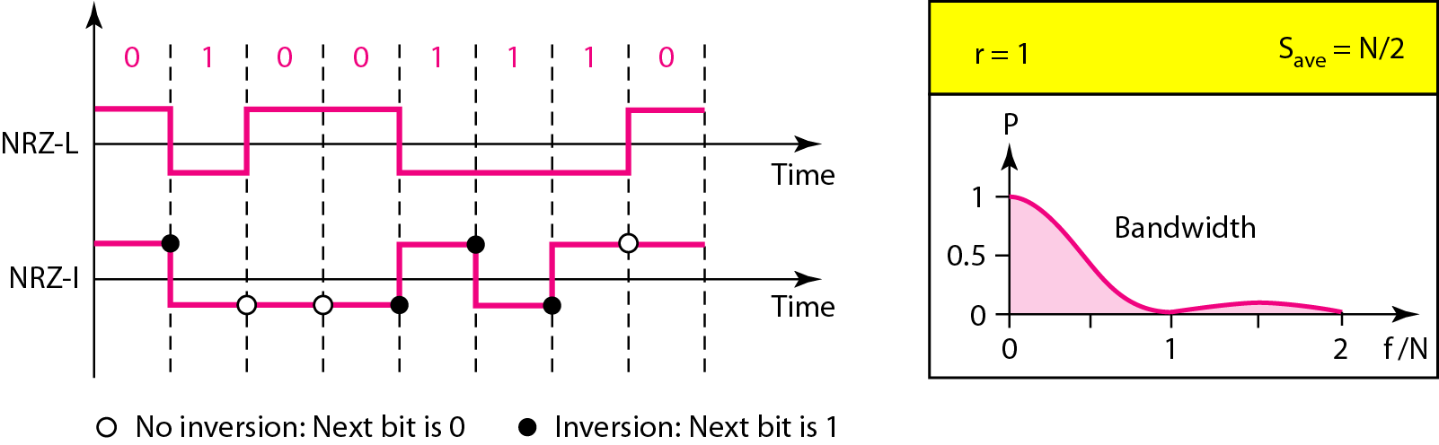
2. Polar Line Coding
2.1 NRZ Scheme – NRZ-L & NRZ-I
Figure 4.6 Polar NRZ-L and NRZ-I schemes

Slide 73
Note
In NRZ-L the level of the voltage determines the value of the bit.
In NRZ-I the inversion or the lack of inversion determines the value of the bit.
NRZ-L and NRZ-I both have an average signal rate of N/2 Bd.
NRZ-L and NRZ-I both have a DC component problem.

Slide 74
Example 4.4
A system is using NRZ-I to transfer 10-Mbps data. What are the average signal rate and minimum bandwidth?
Solution
The average signal rate is S = N/2 = 500 kbaud. The minimum bandwidth for this average baud rate is Bmin = S = 500 kHz.

Slide 75
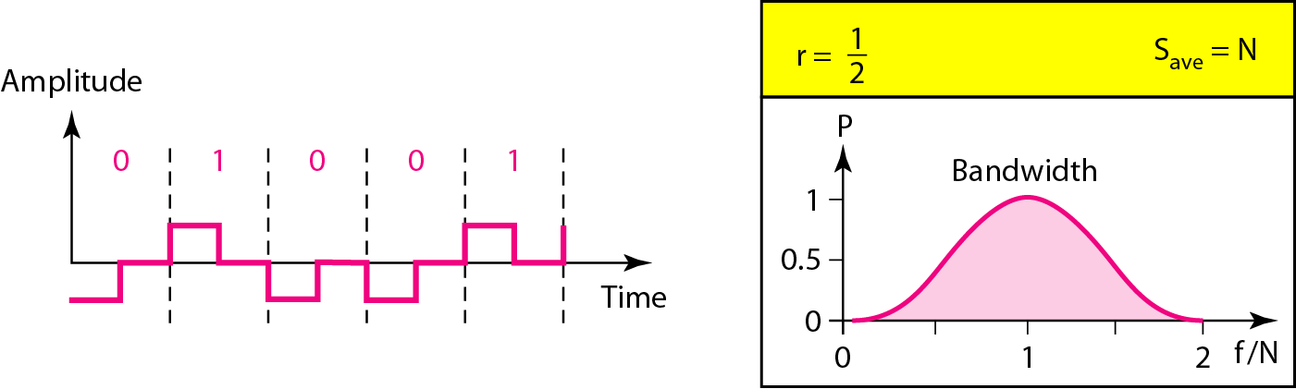
2. Polar Line Coding
2.2 RZ Scheme
Figure 4.7 Polar RZ scheme

Slide 76
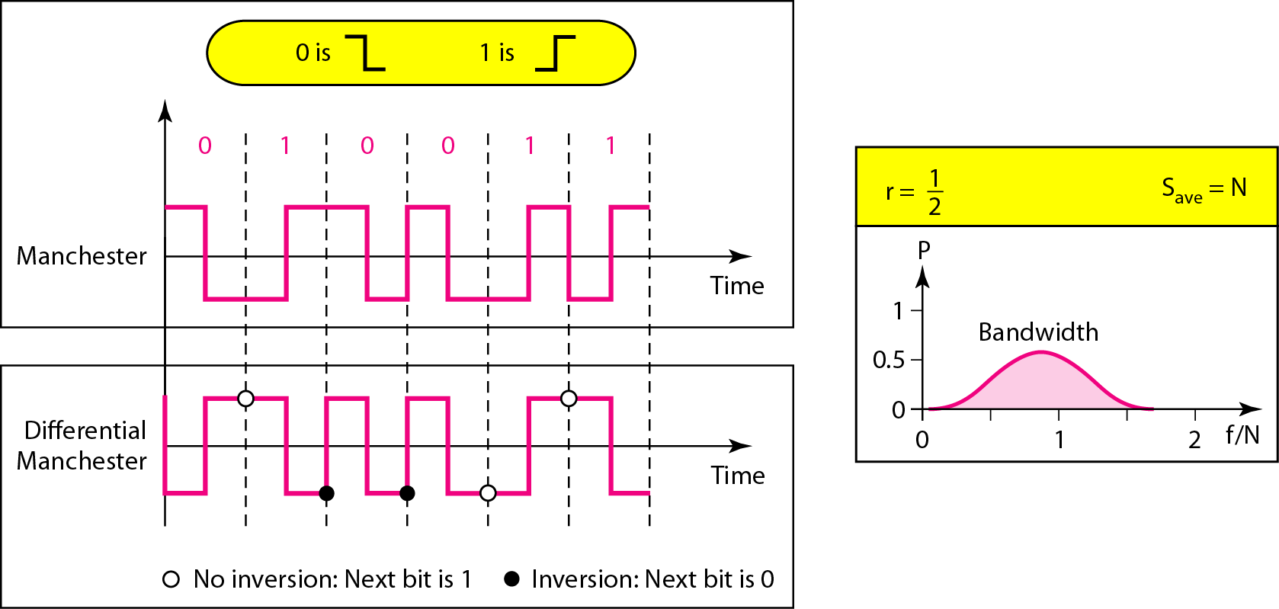
2. Polar Line Coding
2.3 Biphase scheme – Manchester & differential Manchester
Figure 4.8 Polar biphase: Manchester and differential Manchester schemes

Slide 77
Note
In Manchester and differential Manchester encoding, the transition
at the middle of the bit is used for synchronization.
The minimum bandwidth of Manchester and differential Manchester is 2 times that of NRZ.

Slide 78
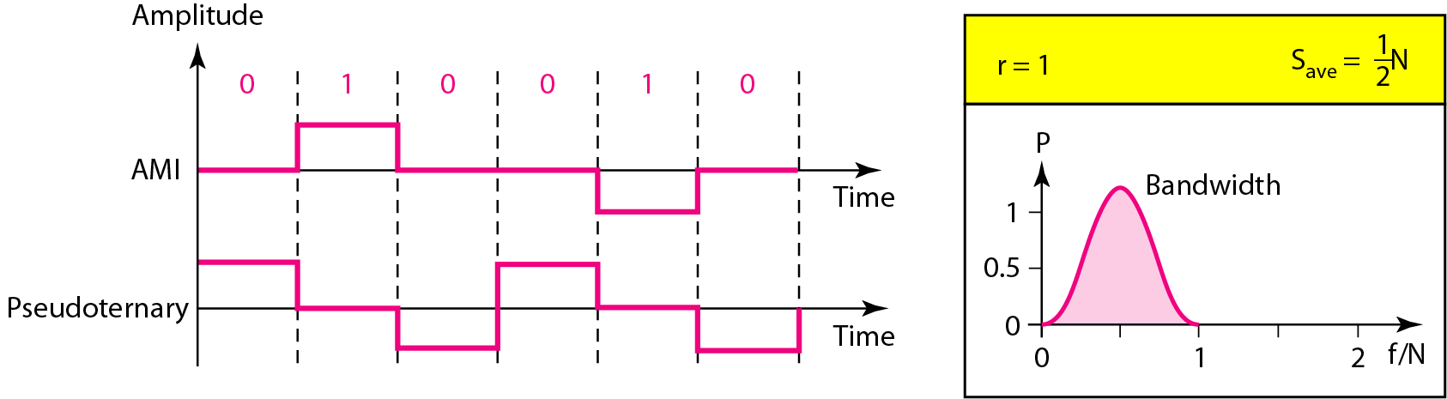
3. Bipolar Line Coding
3.1 AMI & Pseudoternary
Figure 4.9 Bipolar schemes: AMI and pseudoternary
In bipolar encoding, we use three levels: positive, zero, and negative.

Slide 79
4. Multilevel schemes
In mBnL schemes, a pattern of m data elements is encoded as a pattern of n signal elements in which 2^{m} ≤ L^{n}.

Slide 80
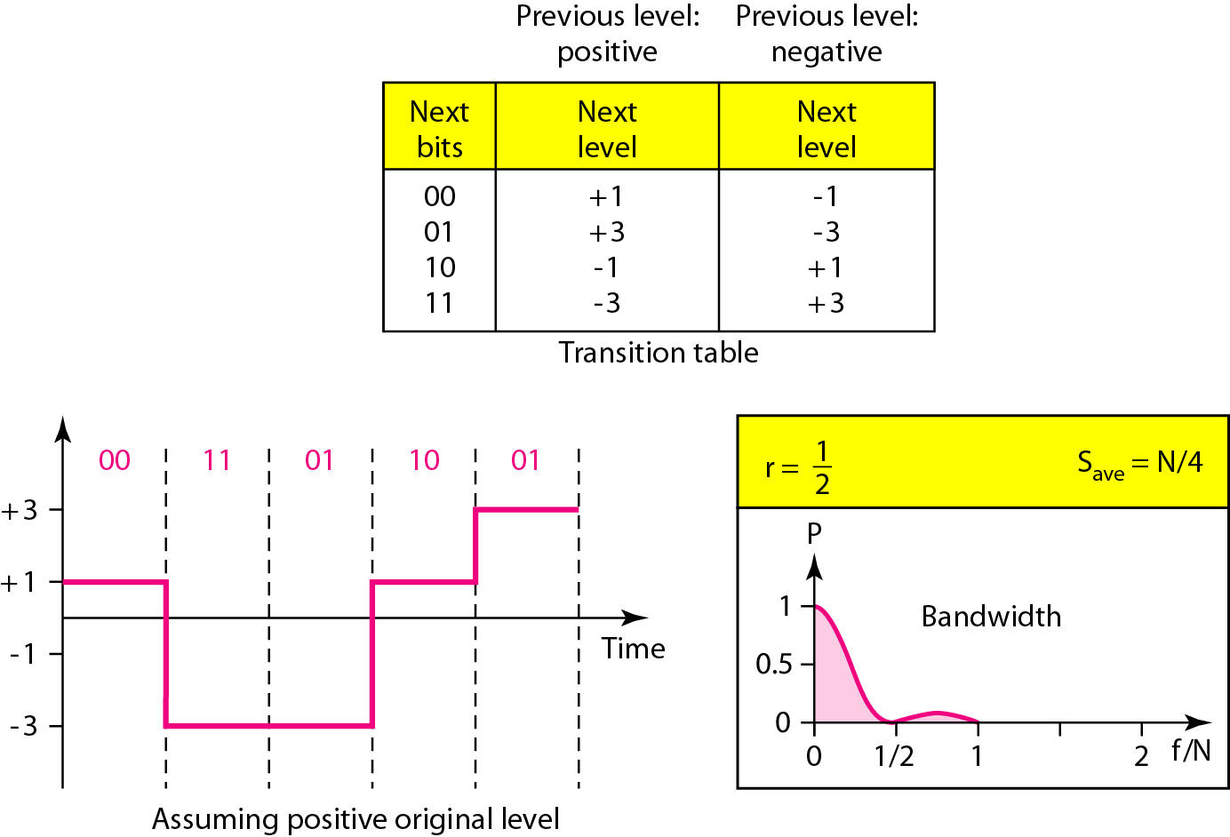
4.1 2B1Q Scheme
Figure 4.10 Multilevel: 2B1Q scheme

Slide 81
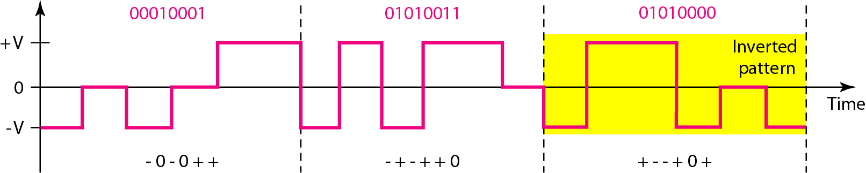
4.2 8B6T Scheme
Figure 4.11 Multilevel: 8B6T scheme

Slide 82
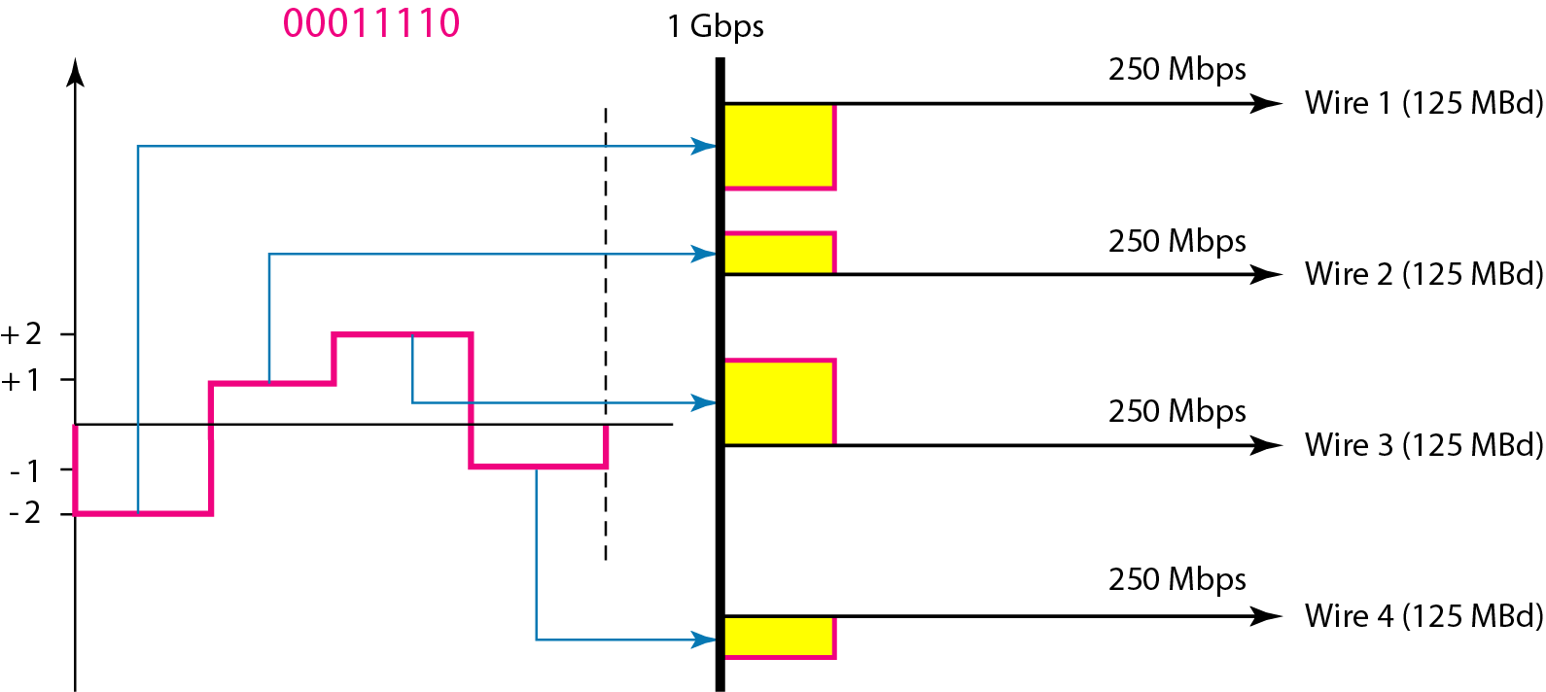
4.3 4D-PAM5 Scheme
Figure 4.12 Multilevel: 4D-PAM5 scheme

Slide 83
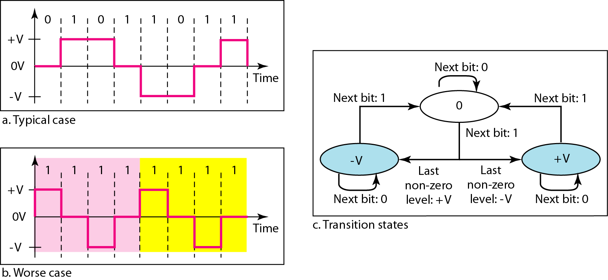
5. Multi-transition schemes
5.1 MLT-3 Scheme
Figure 4.13 Multitransition: MLT-3 scheme

Slide 84
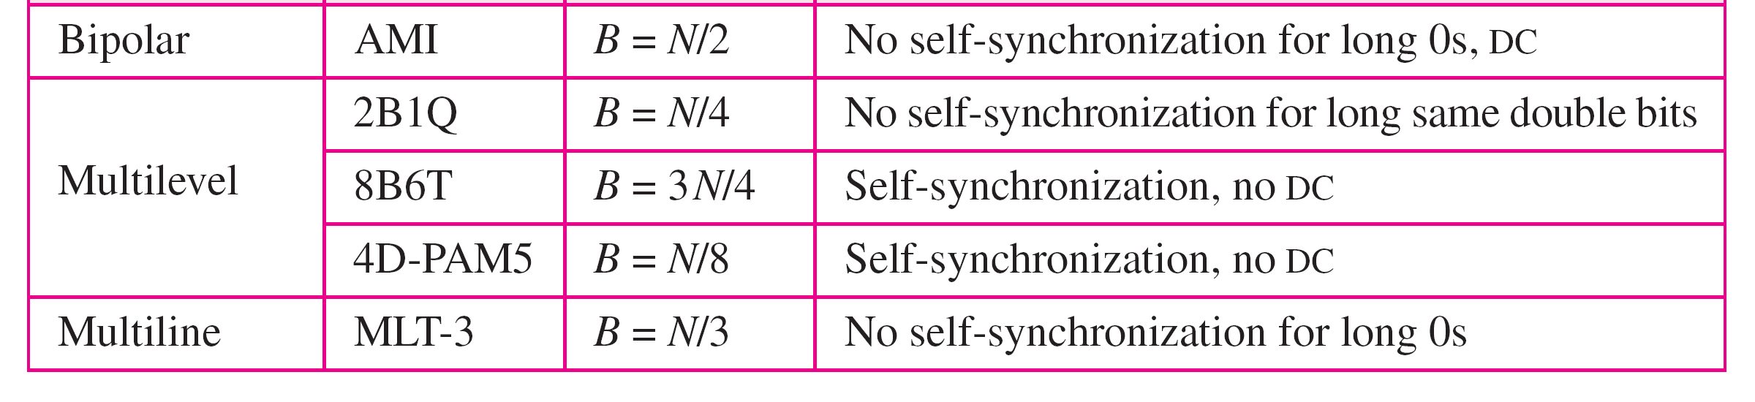
Table 4.1 Summary of line coding schemes

Slide 85
BLOCK CODING SCHEMES
Block coding is normally referred to as mB/nB coding;
it replaces each m-bit group with an n-bit group.

Slide 86
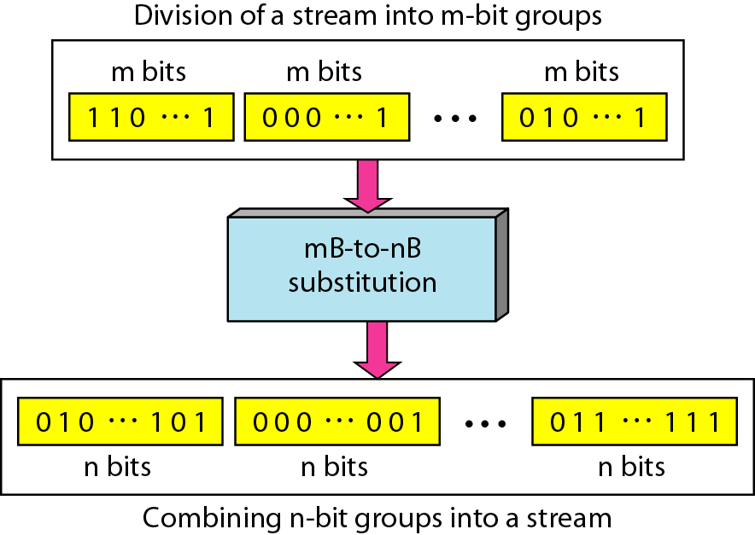
Figure 4.14 Block coding concept

Slide 87
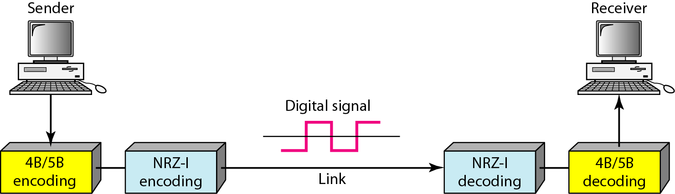
1. 4B/5B scheme
Figure 4.15 Using block coding 4B/5B with NRZ-I line coding scheme

Slide 88
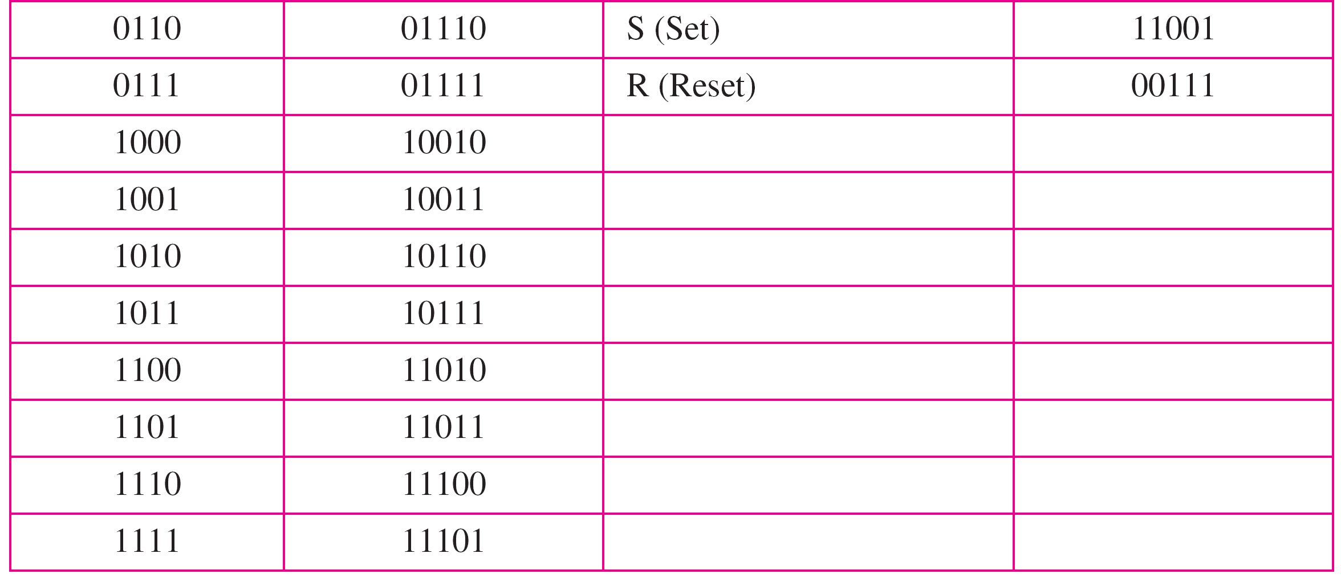
Table 4.2 4B/5B mapping codes

Slide 89
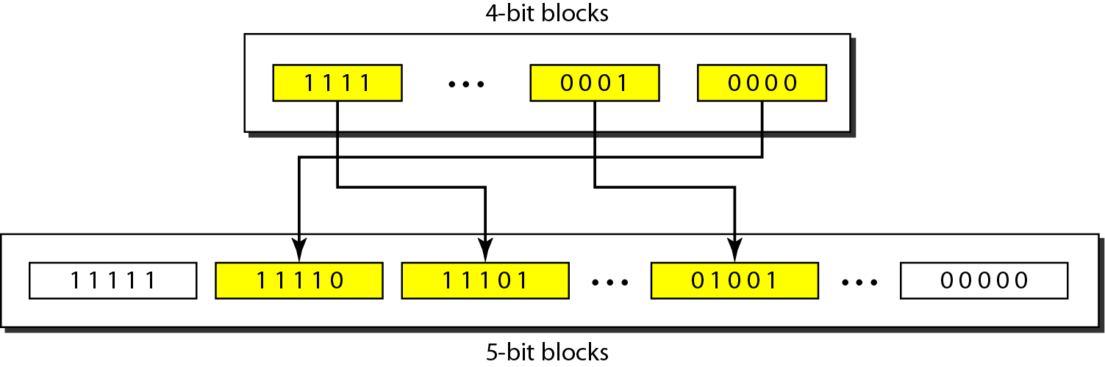
Figure 4.16 Substitution in 4B/5B block coding

Slide 90
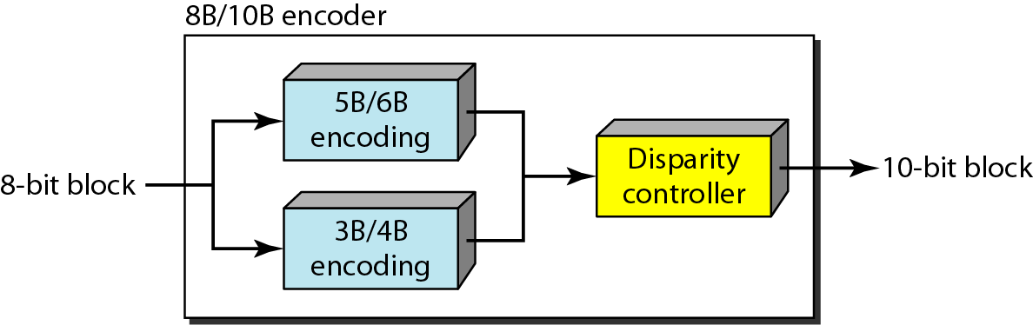
2. 8B/10B scheme
Figure 4.17 8B/10B block encoding

Slide 91
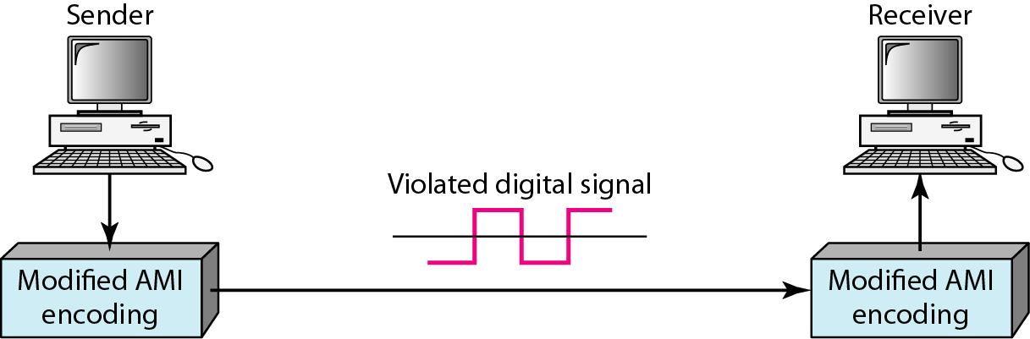
SCRAMBLING
Figure 4.18 AMI used with scrambling

Slide 92
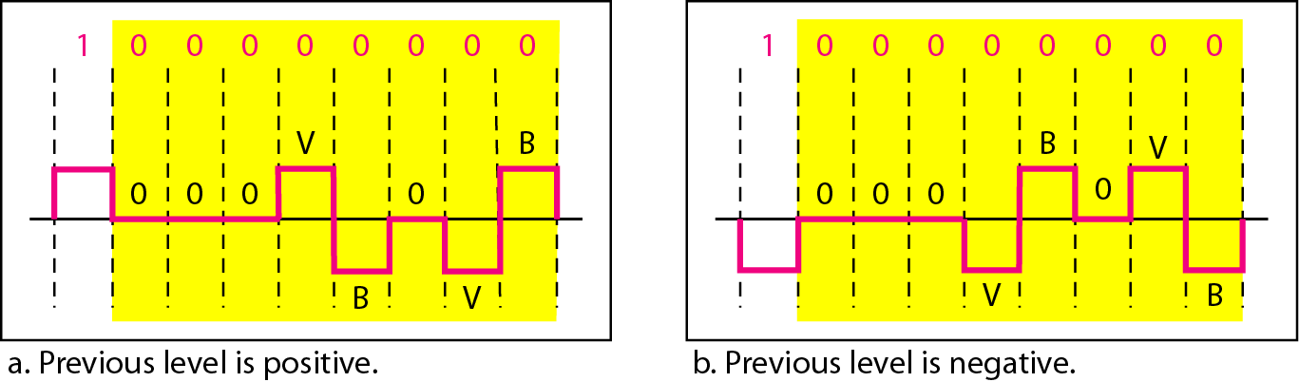
1. B8ZS scheme
B8ZS substitutes eight consecutive zeroes with 000VB0VB.
Figure 4.19 Two cases of B8ZS scrambling technique

Slide 93
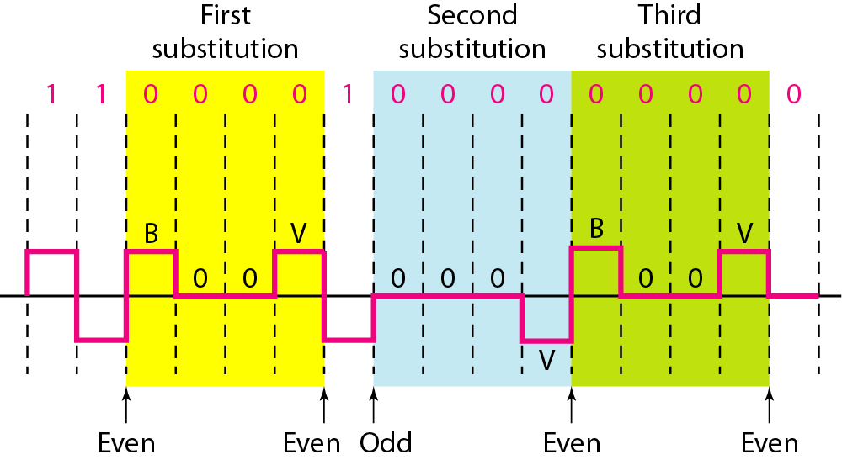
2. HDB3 scheme
HDB3 substitutes four consecutive zeroes with 000V or B00V depending on the number of nonzero pulses after the last substitution.
Figure 4.20 Different situations in HDB3 scrambling technique

Slide 94
4-2 ANALOG-TO-DIGITAL CONVERSION
We have seen in Chapter 3 that a digital signal is superior to an analog signal. The tendency today is to change an analog signal to digital data. In this section we describe two techniques, pulse code modulation and delta modulation.
Topics discussed in this section:
Pulse Code Modulation (PCM)
Delta Modulation (DM)

Slide 95

A. Pulse Code Modulation (PCM)
Figure 4.21 Components of PCM encoder

Slide 96

1. Sampling
Figure 4.22 Three different sampling methods for PCM

Slide 97
Note
According to the Nyquist theorem, the sampling rate must be
at least 2 times the highest frequency contained in the signal.

Slide 98

Figure 4.23 Nyquist sampling rate for low-pass and bandpass signals

Slide 99
Example 4.6
For an intuitive example of the Nyquist theorem, let us sample a simple sine wave at three sampling rates: f_{s} = 4f (2 times the Nyquist rate), f_{s} = 2f (Nyquist rate), and f_{s} = f (one-half the Nyquist rate). Figure 4.24 shows the sampling and the subsequent recovery of the signal.
It can be seen that sampling at the Nyquist rate can create a good approximation of the original sine wave (part a). Oversampling in part b can also create the same approximation, but it is redundant and unnecessary. Sampling below the Nyquist rate (part c) does not produce a signal that looks like the original sine wave.

Slide 100

Figure 4.24 Recovery of a sampled sine wave for different sampling rates

Slide 101
Example 4.7
Consider the revolution of a hand of a clock. The second hand of a clock has a period of 60 s. According to the Nyquist theorem, we need to sample the hand every 30 s (T_{s} = T or f_{s} = 2f ). In Figure 4.25a, the sample points, in order, are 12, 6, 12, 6, 12, and 6. The receiver of the samples cannot tell if the clock is moving forward or backward. In part b, we sample at double the Nyquist rate (every 15 s). The sample points are 12, 3, 6, 9, and 12. The clock is moving forward. In part c, we sample below the Nyquist rate (T_{s} = T or f_{s} = f ). The sample points are 12, 9, 6, 3, and 12. Although the clock is moving forward, the receiver thinks that the clock is moving backward.

Slide 102

Figure 4.25 Sampling of a clock with only one hand

Slide 103
Example 4.8
An example related to Example 4.7 is the seemingly backward rotation of the wheels of a forward-moving car in a movie. This can be explained by under-sampling. A movie is filmed at 24 frames per second. If a wheel is rotating more than 12 times per second, the under-sampling creates the impression of a backward rotation.

Slide 104
Example 4.9
Telephone companies digitize voice by assuming a maximum frequency of 4000 Hz. The sampling rate therefore is 8000 samples per second.

Slide 105
Example 4.10
A complex low-pass signal has a bandwidth of 200 kHz. What is the minimum sampling rate for this signal?
Solution
The bandwidth of a low-pass signal is between 0 and f, where f is the maximum frequency in the signal. Therefore, we can sample this signal at 2 times the highest frequency (200 kHz). The sampling rate is therefore 400,000 samples per second.

Slide 106
Example 4.11
A complex bandpass signal has a bandwidth of 200 kHz. What is the minimum sampling rate for this signal?
Solution
We cannot find the minimum sampling rate in this case because we do not know where the bandwidth starts or ends. We do not know the maximum frequency in the signal.

Slide 107

2. Quantization
Figure 4.26 Quantization and encoding of a sampled signal

Slide 108
SNR (Signal to noise ratio) : Two cases are a high SNR and a low SNR
SNR = (average signal power / average noise power) [Unit: decibel (dB)]

Slide 109
Contribution of quantization error to SNRdB of signal depends on number of levels L or bits per sample nb
Example 4.12
What is the SNRdB in the example of Figure 4.26?
Solution
We can use the formula to find the quantization. We have eight levels and 3 bits per sample, so
SNRdB = 6.02(3) + 1.76 = 19.82 dB
Increasing the number of levels increases the SNR.

Slide 110
Example 4.13
A telephone subscriber line must have an SNRdB above 40. What is the minimum number of bits per sample?
Solution
We can calculate the number of bits as
Telephone companies usually assign 7 or 8 bits per sample.

Slide 111
3. Encoding
Sampling rate = 2 * Highest Frequency
Bit rate = Sampling rate * no. of bits per sample
Example 4.14
We want to digitize the human voice. What is the bit rate, assuming 8 bits per sample?
Solution
The human voice normally contains frequencies from 0 to 4000 Hz. So the sampling rate and bit rate are calculated as follows:

Slide 112

Original Signal Recovery
Figure 4.27 Components of a PCM decoder

Slide 113
Example 4.15 – PCM Bandwidth
We have a low-pass analog signal of 4 kHz. If we send the analog signal, we need a channel with a minimum bandwidth of 4 kHz. If we digitize the signal and send 8 bits per sample, we need a channel with a minimum bandwidth of 8 × 4 kHz = 32 kHz.

Slide 114

B. Delta Modulation (DM)
Figure 4.28 The process of delta modulation

Slide 115

1. Modulator
Figure 4.29 Delta modulation components

Slide 116

2. Demodulator
Figure 4.30 Delta demodulation components

Slide 117
4-3 TRANSMISSION MODES
The transmission of binary data across a link can be accomplished in either parallel or serial mode. In parallel mode, multiple bits are sent with each clock tick. In serial mode, 1 bit is sent with each clock tick. While there is only one way to send parallel data, there are three subclasses of serial transmission: asynchronous, synchronous, and isochronous.
Topics discussed in this section:
Parallel Transmission Serial Transmission

Slide 118

Figure 4.31 Data transmission and modes

Slide 119

1. Parallel Transmission
Figure 4.32 Parallel transmission

Slide 120

2. Serial Transmission
Figure 4.33 Serial transmission

Slide 121
Note
In asynchronous transmission, we send 1 start bit (0) at the beginning and 1 or more stop bits (1s) at the end of each byte. There may be a gap between each byte.
Asynchronous here means “asynchronous at the byte level,” but the bits are still synchronized; their durations are the same.

Slide 122

2.1 Asynchronous Transmission
Figure 4.34 Asynchronous transmission

Slide 123
Note
In synchronous transmission, we send bits one after another without start or stop bits or gaps. It is the responsibility of the receiver to group the bits.

Slide 124

2.2 Synchronous Transmission
Figure 4.35 Synchronous transmission

Slide 125
2.3 Isochronous Transmission
In real-time audio and video, in which uneven delays between frames are not acceptable, synchronous transmission fails.
For example, TV images are broadcast at the rate of 30 images per second; they must be viewed at the same rate.
If each image is sent by using one or more frames, there should be no delays between frames.
For this type of application, synchronization between characters is not enough; the entire stream of bits must be synchronized.
The isochronous transmission guarantees that the data arrive at a fixed rate.

Slide 126
Chapter 5
Analog Transmission
Copyright © The McGraw-Hill Companies, Inc. Permission required for reproduction or display.

Slide 127
5-1 DIGITAL-TO-ANALOG CONVERSION
Digital-to-analog conversion is the process of changing one of the characteristics of an analog signal based on the information in digital data.
Topics discussed in this section:
Aspects of Digital-to-Analog Conversion Amplitude Shift Keying Frequency Shift Keying
Phase Shift Keying
Quadrature Amplitude Modulation

Slide 128

Figure 5.1 Digital-to-analog conversion

Slide 129

Figure 5.2 Types of digital-to-analog conversion

Slide 130
Note
Bit rate is the number of bits per second.
Baud rate is the number of signal elements per second.
In the analog transmission of digital data, the baud rate is less than or equal to the bit rate.
In analog transmission, the sending device produces a high-frequency signal that acts as a base for the information signal. This base signal is called the carrier signal or carrier frequency.

Slide 131
Example 5.1
An analog signal carries 4 bits per signal element. If 1000 signal elements are sent per second, find the bit rate.
Solution
In this case, r = 4, S = 1000, and N is unknown. We can find the value of N from

Slide 132
Example 5.2
An analog signal has a bit rate of 8000 bps and a baud rate of 1000 baud. How many data elements are carried by each signal element? How many signal elements do we need?
Solution
In this example, S = 1000, N = 8000, and r and L are unknown. We find first the value of r and then the value of L.

Slide 133
Note
Bandwidth:
The required bandwidth for analog transmission of digital data is proportional to the signal rate except for FSK
Carrier Signal:
In analog transmission, the sending device produces a high-frequency signal that acts as a base for the information signal. This base signal is called the carrier signal or carrier frequency.
Modulation:
The receiving device is tuned to the frequency of the carrier signal that it expects from the sender. Digital information then changes the carrier signal by modifying one or more of its characteristics (amplitude, frequency, or phase). This kind of modification is called modulation (shift keying).

Slide 134

1. Amplitude Shift Keying (ASK)
1.1 Binary ASK (BASK)
Figure 5.3 Binary amplitude shift keying

Slide 135

Figure 5.4 Implementation of binary ASK

Slide 136
1.2 Multilevel ASK (MASK)
There are more than two levels.
We can use 4,8, 16, or more different amplitudes for the signal and modulate the data using 2, 3, 4, or more bits at a time.
In these cases, r = 2, r = 3, r =4, and so on.

Slide 137
Example 5.3
We have an available bandwidth of 100 kHz which spans from 200 to 300 kHz. What are the carrier frequency and the bit rate if we modulated our data by using ASK with d = 1?
Solution
The middle of the bandwidth is located at 250 kHz. This means that our carrier frequency can be at f_{c} = 250 kHz. We can use the formula for bandwidth to find the bit rate (with d = 1 and r = 1).

Slide 138
Example 5.4
In data communications, we normally use full-duplex links with communication in both directions. We need to divide the bandwidth into two with two carrier frequencies, as shown in Figure 5.5. The figure shows the positions of two carrier frequencies and the bandwidths. The available bandwidth for each direction is now 50 kHz, which leaves us with a data rate of 25 kbps in each direction.

Slide 139

Figure 5.5 Bandwidth of full-duplex ASK used in Example 5.4

Slide 140

2. Frequency Shift Keying (FSK)
2.1 Binary FSK (BFSK)
Figure 5.6 Binary frequency shift keying

Slide 141
Example 5.5
We have an available bandwidth of 100 kHz which spans from 200 to 300 kHz. What should be the carrier frequency and the bit rate if we modulated our data by using FSK with d = 1?
Solution
This problem is similar to Example 5.3, but we are modulating by using FSK. The midpoint of the band is at 250 kHz. We choose 2Δf to be 50 kHz; this means

Slide 142

Figure 5.7 Implementation of BFSK

Slide 143
2.2 Multilevel FSK (MFSK)
Example 5.6
We need to send data 3 bits at a time at a bit rate of 3 Mbps. The carrier frequency is 10 MHz. Calculate the number of levels (different frequencies), the baud rate, and the bandwidth.
Solution
We can have L = 23 = 8. The baud rate is S = 3 MHz/3 = 1000 Mbaud. This means that the carrier frequencies must be 1 MHz apart (2Δf = 1 MHz). The bandwidth is B = 8 × 1000 = 8000. Figure 5.8 shows the allocation of frequencies and bandwidth.

Slide 144

Figure 5.8 Bandwidth of MFSK used in Example 5.6

Slide 145

3. Phase Shift Keying (PSK)
3.1 Binary PSK (BPSK)
Figure 5.9 Binary phase shift keying

Slide 146

Figure 5.10 Implementation of BPSK

Slide 147

3.2 Quadrature PSK (QPSK)
Figure 5.11 QPSK and its implementation

Slide 148
Example 5.7
Find the bandwidth for a signal transmitting at 12 Mbps for QPSK. The value of d = 0.
Solution
For QPSK, 2 bits is carried by one signal element. This means that r = 2. So the signal rate (baud rate) is S = N × (1/r) = 6 Mbaud. With a value of d = 0, we have B = S = 6 MHz.

Slide 149

CONSTELLATION DIAGRAM
Figure 5.12 Concept of a constellation diagram

Slide 150

Example 5.8
Show the constellation diagrams for an ASK (OOK), BPSK, and QPSK signals.
Solution
Figure 5.13 shows the three constellation diagrams.
Figure 5.13 Three constellation diagrams

Slide 151

Quadrature Amplitude Modulation (QAM)
QAM is a combination of ASK and PSK.
Figure 5.14 Constellation diagrams for some QAMs

Slide 152
5-2 ANALOG AND DIGITAL
Analog-to-analog conversion is the representation of analog information by an analog signal. One may ask why we need to modulate an analog signal; it is already analog. Modulation is needed if the medium is bandpass in nature or if only a bandpass channel is available to us.
Topics discussed in this section:
Amplitude Modulation Frequency Modulation Phase Modulation

Slide 153

Figure 5.15 Types of analog-to-analog modulation

Slide 154

1. Amplitude Modulation (AM)
Figure 5.16 Amplitude modulation

Slide 155

Note
The total bandwidth required for AM can be determined
from the bandwidth of the audio signal: B_{AM} = 2B.
Figure 5.17 AM band allocation

Slide 156

2. Frequency Modulation (FM)
Figure 5.18 Frequency modulation

Slide 157

Note
The total bandwidth required for FM can be determined from the bandwidth of the audio signal: B_{FM} = 2(1 + β)B.
Figure 5.19 FM band allocation

Slide 158

3. Phase Modulation (PM)
Figure 5.20 Phase modulation

Slide 159
Note
The total bandwidth required for PM can be determined from the bandwidth and maximum amplitude of the modulating signal: B_{PM} = 2(1 + β)B.

Slide 160
Chapter 6
Bandwidth Utilization:
Multiplexing and Spreading
Copyright © The McGraw-Hill Companies, Inc. Permission required for reproduction or display.

Slide 161
Note
Bandwidth utilization is the wise use of available bandwidth to achieve specific goals.
Efficiency can be achieved by multiplexing; privacy and anti-jamming can be achieved by spreading.

Slide 162
6-1 MULTIPLEXING
Whenever the bandwidth of a medium linking two devices is greater than the bandwidth needs of the devices, the link can be shared. Multiplexing is the set of techniques that allows the simultaneous transmission of multiple signals across a single data link. As data and telecommunications use increases, so does traffic.
Topics discussed in this section:
Frequency-Division Multiplexing Wavelength-Division Multiplexing Synchronous Time-Division Multiplexing
Statistical Time-Division Multiplexing

Slide 163

Figure 6.1 Dividing a link into channels

Slide 164

Figure 6.2 Categories of multiplexing

Slide 165

1. Frequency Division Multiplexing (FDM)
Figure 6.3 Frequency-division multiplexing
FDM is an analog multiplexing technique that combines analog signals.

Slide 166

Figure 6.4 FDM process

Slide 167

Figure 6.5 FDM demultiplexing example

Slide 168

Figure 6.9 Analog hierarchy

Slide 169
Example 6.1
Assume that a voice channel occupies a bandwidth of 4 kHz. We need to combine three voice channels into a link with a bandwidth of 12 kHz, from 20 to 32 kHz. Show the configuration, using the frequency domain. Assume there are no guard bands.
Solution
We shift (modulate) each of the three voice channels to a different bandwidth, as shown in Figure 6.6. We use the 20- to 24-kHz bandwidth for the first channel, the 24- to 28-kHz bandwidth for the second channel, and the 28- to 32-kHz bandwidth for the third one. Then we combine them as shown in Figure 6.6.

Slide 170

Figure 6.6 Example 6.1

Slide 171
Example 6.2
Five channels, each with a 100-kHz bandwidth, are to be multiplexed together. What is the minimum bandwidth of the link if there is a need for a guard band of 10 kHz between the channels to prevent interference?
Solution
For five channels, we need at least four guard bands. This means that the required bandwidth is at least
5 × 100 + 4 × 10 = 540 kHz,
as shown in Figure 6.7.

Slide 172

Figure 6.7 Example 6.2

Slide 173

2. Wavelength Division Multiplexing (WDM)
Figure 6.10 Wavelength-division multiplexing
WDM is an analog multiplexing technique to combine optical signals.

Slide 174

Figure 6.11 Prisms in wavelength-division multiplexing and demultiplexing

Slide 175

3. Time Division Multiplexing (TDM)
Figure 6.12 TDM
TDM is a digital multiplexing technique for combining several low-rate channels into one high-rate one.

Slide 176
Time Division Multiplexing
Synchronous Time Division Multiplexing
Statistical Time Division Multiplexing

Slide 177

3.1 Synchronous Time Division Multiplexing (TDM)
Figure 6.13 Synchronous time-division multiplexing
In synchronous TDM, the data rate of the link is n times faster, and the unit duration is n times shorter.

Slide 178
Example 6.5
In Figure 6.13, the data rate for each input connection is 3 kbps. If 1 bit at a time is multiplexed (a unit is 1 bit), what is the duration of (a) each input slot, (b) each output slot, and (c) each frame?
Solution
We can answer the questions as follows:
a. The data rate of each input connection is 1 kbps. This means that the bit duration is 1/1000 s or 1 ms. The duration of the input time slot is 1 ms (same as bit duration).

Slide 179
Example 6.5 (continued)
b. The duration of each output time slot is one-third of the input time slot. This means that the duration of the output time slot is 1/3 ms.
c. Each frame carries three output time slots. So the duration of a frame is 3 × 1/3 ms, or 1 ms. The duration of a frame is the same as the duration of an input unit.

Slide 180
Example 6.6
Figure 6.14 shows synchronous TDM with a data stream for each input and one data stream for the output. The unit of data is 1 bit. Find (a) the input bit duration, (b) the output bit duration, (c) the output bit rate, and (d) the output frame rate.
Solution
We can answer the questions as follows:
a. The input bit duration is the inverse of the bit rate: 1/1 Mbps = 1 μs.
b. The output bit duration is one-fourth of the input bit duration, or ¼ μs.

Slide 181
Example 6.6 (continued)
c. The output bit rate is the inverse of the output bit duration or 1/(4μs) or 4 Mbps. This can also be deduced from the fact that the output rate is 4 times as fast as any input rate; so the output rate = 4 × 1 Mbps = 4 Mbps.
d. The frame rate is always the same as any input rate. So the frame rate is 1,000,000 frames per second. Because we are sending 4 bits in each frame, we can verify the result of the previous question by multiplying the frame rate by the number of bits per frame.

Slide 182

Figure 6.14 Example 6.6

Slide 183
Example 6.7
Four 1-kbps connections are multiplexed together. A unit is 1 bit. Find (a) the duration of 1 bit before multiplexing, (b) the transmission rate of the link, (c) the duration of a time slot, and (d) the duration of a frame.
Solution
We can answer the questions as follows:
a. The duration of 1 bit before multiplexing is 1 / 1 kbps, or 0.001 s (1 ms).
b. The rate of the link is 4 times the rate of a connection, or 4 kbps.

Slide 184
Example 6.7 (continued)
c. The duration of each time slot is one-fourth of the duration of each bit before multiplexing, or 1/4 ms or 250 μs. Note that we can also calculate this from the data rate of the link, 4 kbps. The bit duration is the inverse of the data rate, or 1/4 kbps or 250 μs.
d. The duration of a frame is always the same as the duration of a unit before multiplexing, or 1 ms. We can also calculate this in another way. Each frame in this case has four time slots. So the duration of a frame is 4 times 250 μs, or 1 ms.

Slide 185

Figure 6.15 Interleaving

Slide 186
Example 6.8
Four channels are multiplexed using TDM. If each channel sends 100 bytes /s and we multiplex 1 byte per channel, show the frame traveling on the link, the size of the frame, the duration of a frame, the frame rate, and the bit rate for the link.
Solution
The multiplexer is shown in Figure 6.16. Each frame carries 1 byte from each channel; the size of each frame, therefore, is 4 bytes, or 32 bits. Because each channel is sending 100 bytes/s and a frame carries 1 byte from each channel, the frame rate must be 100 frames per second. The bit rate is 100 × 32, or 3200 bps.

Slide 187

Figure 6.16 Example 6.8

Slide 188
Example 6.9
A multiplexer combines four 100-kbps channels using a time slot of 2 bits. Show the output with four arbitrary inputs. What is the frame rate? What is the frame duration? What is the bit rate? What is the bit duration?
Solution
Figure 6.17 shows the output for four arbitrary inputs. The link carries 50,000 frames per second. The frame duration is therefore 1/50,000 s or 20 μs. The frame rate is 50,000 frames per second, and each frame carries 8 bits; the bit rate is 50,000 × 8 = 400,000 bits or 400 kbps. The bit duration is 1/400,000 s, or 2.5 μs.

Slide 189

Figure 6.17 Example 6.9

Slide 190

Data Rate Management
1. Multilevel multiplexing
Figure 6.19 Multilevel multiplexing

Slide 191

Data Rate Management
2. Multiple-slot multiplexing
Figure 6.20 Multiple-slot multiplexing

Slide 192

Data Rate Management
3. Pulse Stuffing
Figure 6.21 Pulse stuffing

Slide 193

Framing Bits
Figure 6.22 Framing bits

Slide 194

Empty slots
Figure 6.18 Empty slots

Slide 195
Example 6.10
We have four sources, each creating 250 characters per second. If the interleaved unit is a character and 1 synchronizing bit is added to each frame, find (a) the data rate of each source, (b) the duration of each character in each source, (c) the frame rate, (d) the duration of each frame, (e) the number of bits in each frame, and (f) the data rate of the link.
Solution
We can answer the questions as follows:
a. The data rate of each source is 250 × 8 = 2000 bps = 2 kbps.

Slide 196
Example 6.10 (continued)
b. Each source sends 250 characters per second; therefore, the duration of a character is 1/250 s, or 4 ms.
c. Each frame has one character from each source, which means the link needs to send 250 frames per second to keep the transmission rate of each source.
d. The duration of each frame is 1/250 s, or 4 ms. Note that the duration of each frame is the same as the duration of each character coming from each source.
e. Each frame carries 4 characters and 1 extra synchronizing bit. This means that each frame is 4 × 8 + 1 = 33 bits.

Slide 197
Example 6.11
Two channels, one with a bit rate of 100 kbps and another with a bit rate of 200 kbps, are to be multiplexed. How this can be achieved? What is the frame rate? What is the frame duration? What is the bit rate of the link?
Solution
We can allocate one slot to the first channel and two slots to the second channel. Each frame carries 3 bits. The frame rate is 100,000 frames per second because it carries 1 bit from the first channel. The bit rate is 100,000 frames/s × 3 bits per frame, or 300 kbps.

Slide 198

3.2 Statistical Time Division Multiplexing (TDM)
Figure 6.26 TDM slot comparison

Slide 199
6-2 SPREAD SPECTRUM
In spread spectrum (SS), we combine signals from different sources to fit into a larger bandwidth, but our goals are to prevent eavesdropping and jamming. To achieve these goals, spread spectrum techniques add redundancy.
Topics discussed in this section:
Frequency Hopping Spread Spectrum (FHSS) Direct Sequence Spread Spectrum Synchronous (DSSS)

Slide 200

Figure 6.27 Spread spectrum

Slide 201

1. Frequency Hopping Spread Spectrum (FHSS)
Figure 6.28 Frequency hopping spread spectrum (FHSS)

Slide 202

Figure 6.29 Frequency selection in FHSS

Slide 203

Figure 6.30 FHSS cycles

Slide 204

Figure 6.31 Bandwidth sharing

Slide 205

2. Direct Sequence Spread Spectrum (DSSS)
Figure 6.32 DSSS

Slide 206

Figure 6.33 DSSS example

Slide 207
Chapter 8
Switching
Copyright © The McGraw-Hill Companies, Inc. Permission required for reproduction or display.

Slide 208

Figure 8.1 Switched network

Slide 209

Figure 8.2 Taxonomy of switched networks

Slide 210
8-1 CIRCUIT-SWITCHED NETWORKS
A circuit-switched network consists of a set of switches connected by physical links. A connection between two stations is a dedicated path made of one or more links. However, each connection uses only one dedicated channel on each link. Each link is normally divided into n channels by using FDM or TDM.
Topics discussed in this section:
Three Phases Efficiency Delay
Circuit-Switched Technology in Telephone Networks

Slide 211

Figure 8.3 A trivial circuit-switched network

Slide 212
Note
A circuit-switched network is made of a set of switches connected by physical links, in which each link is divided into n channels.
In circuit switching, the resources need to be reserved during the setup phase; the resources remain dedicated for the entire duration of data transfer until the teardown phase.

Slide 213
Three Phases of Circuit Switched Networks:
Setup Phase
Data Transfer Phase
Teardown Phase
Efficiency
Delay

Slide 214

Figure 8.6 Delay in a circuit-switched network

Slide 215
Note
Switching at the physical layer in the traditional telephone network uses
the circuit-switching approach.

Slide 216
8-2 DATAGRAM NETWORKS
In data communications, we need to send messages from one end system to another. If the message is going to pass through a packet-switched network, it needs to be divided into packets of fixed or variable size. The size of the packet is determined by the network and the governing protocol.
Topics discussed in this section:
Routing Table Efficiency Delay
Datagram Networks in the Internet

Slide 217

In a packet-switched network, there is no resource reservation;
resources are allocated on demand.
Figure 8.7 A datagram network with four switches (routers)

Slide 218

A switch in a datagram network uses a routing table that is based on the destination address.
Figure 8.8 Routing table in a datagram network

Slide 219
Note
The destination address in the header of a packet in a datagram network
remains the same during the entire journey of the packet.

Slide 220

Figure 8.9 Delay in a datagram network

Slide 221
Note
Switching in the Internet is done by using the datagram approach to packet switching at the network layer.

Slide 222
8-3 VIRTUAL-CIRCUIT NETWORKS
A virtual-circuit network is a cross between a circuit-switched network and a datagram network. It has some characteristics of both.
Topics discussed in this section:
Addressing Three Phases
Efficiency Delay
Circuit-Switched Technology in WANs

Slide 223

Figure 8.10 Virtual-circuit network

Slide 224

Figure 8.11 Virtual-circuit identifier

Slide 225

Figure 8.12 Switch and tables in a virtual-circuit network

Slide 226

Figure 8.13 Source-to-destination data transfer in a virtual-circuit network

Slide 227

Figure 8.14 Setup request in a virtual-circuit network

Slide 228

Figure 8.15 Setup acknowledgment in a virtual-circuit network

Slide 229
Note
In virtual-circuit switching, all packets belonging to the same source and destination travel the same path;
but the packets may arrive at the destination with different delays if resource allocation is on demand.

Slide 230

Figure 8.16 Delay in a virtual-circuit network

Slide 231
Note
Switching at the data link layer in a switched WAN is normally
implemented by using virtual-circuit techniques.

Slide 232
8-4 STRUCTURE OF A SWITCH
We use switches in circuit-switched and packet-switched networks. In this section, we discuss the structures of the switches used in each type of network.
Topics discussed in this section:
Structure of Circuit Switches Structure of Packet Switches

Slide 233
Taxonomy of switch using different type of networks
Switch structure
Circuit switches
Space-division switch
Crossbar switch
Multistage switch
Time-division switch
Time and space- division switch combinations
Packet switches
Banyan switch
Batcher-Banyan switch

Slide 234

1. CIRCUIT SWITCHES
1.1 Space-division Switch: (a) Crossbar switch
Figure 8.17 Crossbar switch with three inputs and four outputs

Slide 235

1. CIRCUIT SWITCHES
1.1 Space-division Switch: (b) Multistage switch
Figure 8.18 Multistage switch

Slide 236
Note
In a three-stage switch, the total number of cross points is 2kN + k(N/n)²
which is much smaller than the number of cross points in a single-stage switch (N²).

Slide 237
Example 8.3
Design a three-stage, 200 × 200 switch (N = 200) with k = 4 and n = 20.
Solution
In the first stage we have N/n or 10 crossbars, each of size 20 × 4. In the second stage, we have 4 crossbars, each of size 10 × 10. In the third stage, we have 10 crossbars, each of size 4 × 20. The total number of crosspoints is 2kN + k(N/n)², or 2000 crosspoints. This is 5 percent of the number of crosspoints in a single-stage switch (200 × 200 = 40,000).

Slide 238
Note
According to the Clos criterion:
n = (N/2)^{1/2}
k > 2n – 1
Cross points ≥ 4N [(2N)^{1/2} – 1]

Slide 239
Example 8.4
Redesign the previous three-stage, 200 × 200 switch, using the Clos criteria with a minimum number of crosspoints.
Solution
We let n = (200/2)^{1/2}, or n = 10. We calculate k = 2n − 1 = 19. In the first stage, we have 200/10, or 20, crossbars, each with 10 × 19 crosspoints. In the second stage, we have 19 crossbars, each with 10 × 10 crosspoints. In the third stage, we have 20 crossbars each with 19 × 10 crosspoints. The total number of crosspoints is 20(10 × 19) + 19(10 × 10) + 20(19 ×10) = 9500.

Slide 240

1. CIRCUIT SWITCHES
1.2 Time-division Switch
Figure 8.19 Time-slot interchange

Slide 241

1. CIRCUIT SWITCHES
1.3 Time- and Space-division Switch Combination
Figure 8.20 Time-space-time switch

Slide 242

2. PACKET SWITCHES
Figure 8.21 Packet switch components

Slide 243


Components of Packet switches
Figure 8.22 Input port
Figure 8.23 Output port

Slide 244
Components of Packet switches
Routing processor
Performs functions at Network layer
Also known as Table lookup
Destination address is used to find address of next hop & output port no. (of source)
Switching Fabrics
Used to move packet from input queue to output queue
Crossbar switch
Banyan switch
Batcher-Banyan switch

Slide 245

Figure 8.24 A banyan switch

Slide 246

Figure 8.25 Examples of routing in a banyan switch

Slide 247

Figure 8.26 Batcher-banyan switch

Slide 248
Chapter 7
Transmission Media
Copyright © The McGraw-Hill Companies, Inc. Permission required for reproduction or display.

Slide 249

Figure 7.1 Transmission medium and physical layer

Slide 250

Figure 7.2 Classes of transmission media

Slide 251
7-1 GUIDED MEDIA
Guided media, which are those that provide a conduit (i.e. channel) from one device to another, include twisted-pair cable, coaxial cable, and fiber-optic cable.
Topics discussed in this section:
Twisted-Pair Cable
Coaxial Cable
Fiber-Optic Cable

Slide 252

1. Twisted-pair cable
Figure 7.3 Twisted-pair cable

Slide 253

Two types of Twisted-pair cable:
Unshielded Twisted Pair (UTP) cables
Shielded Twisted Pair (STP) cables
Figure 7.4 UTP and STP cables

Slide 254
Table 7.1 Categories of unshielded twisted-pair cables

Slide 255

Figure 7.5 UTP connector

Slide 256

Figure 7.6 UTP performance

Slide 257

2. Coaxial cable
Figure 7.7 Coaxial cable

Slide 258


Table 7.2 Categories of coaxial cables
Figure 7.8 BNC connectors

Slide 259

Figure 7.9 Coaxial cable performance

Slide 260

3. Optical-Fiber cable
Figure 7.10 Bending of light ray

Slide 261

Figure 7.11 Optical fiber

Slide 262

Figure 7.12 Propagation modes

Slide 263

Figure 7.13 Modes

Slide 264
Table 7.3 Fiber types

Slide 265

Figure 7.14 Fiber construction

Slide 266

Figure 7.15 Fiber-optic cable connectors

Slide 267

Figure 7.16 Optical fiber performance

Slide 268
7-2 UNGUIDED MEDIA: WIRELESS
Unguided media transport electromagnetic waves without using a physical conductor. This type of communication is often referred to as wireless communication.
Topics discussed in this section:
Radio Waves
Microwaves
Infrared

Slide 269

Figure 7.17 Electromagnetic spectrum for wireless communication

Slide 270

Figure 7.18 Propagation methods

Slide 271
Table 7.4 Bands

Slide 272

Figure 7.19 Wireless transmission waves

Slide 273

Figure 7.20 Omnidirectional antenna

Slide 274

Figure 7.21 Unidirectional antennas

Slide 275
Note
Radio waves are used for multicast communications, such as radio and television, and paging systems.
Microwaves are used for unicast communication such as cellular telephones, satellite networks, and wireless LANs.
Infrared signals can be used for short-range communication in a closed area using line-of-sight propagation.

